Slide 1
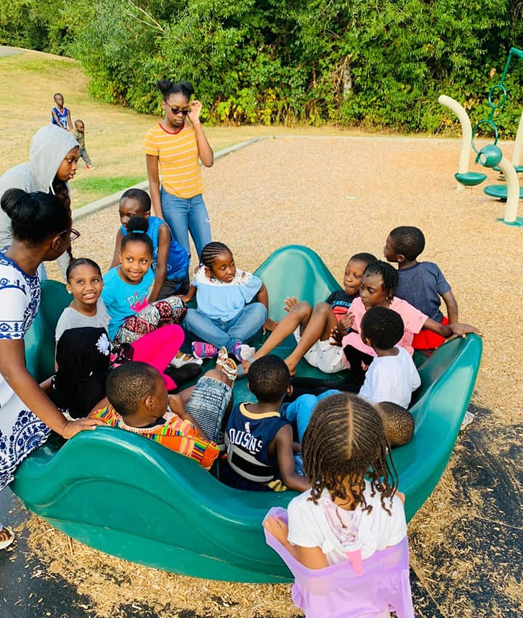

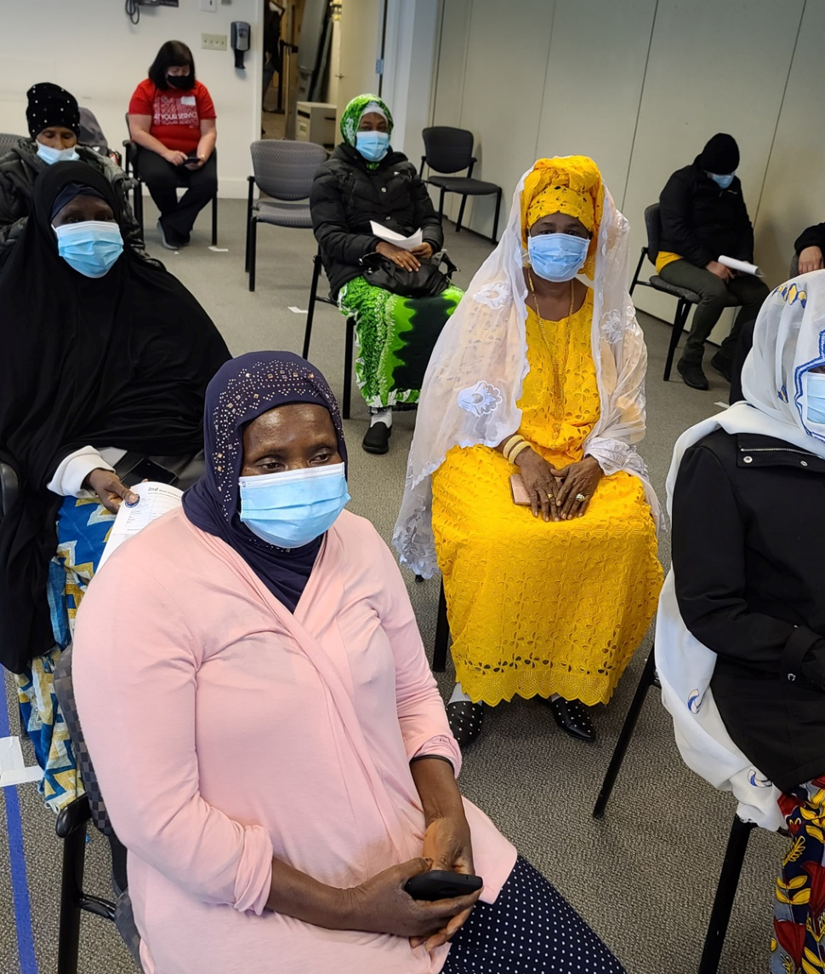
Community Health Assessment for Snohomish county
Leslie Jacobo
Notes:
Introduce self: My name is Leslie Jacobo I’m a third-year public health-global health major at UW
With collaboration from WAWAC we developed a community health assessment for Snohomish county regarding COVID-19 vaccinations.

Slide 2
Summary of the problem
Health Issue
Low COVID-19 vaccination uptake among the West African Community relative to the Snohomish County population
Populations affected
Women, Children, & Seniors (P. Ousman Joof, Personal Communication, May 11, 2022)
What is driving the community health assessment?
Understanding the factors contributing to the low vaccination uptake among the West African community in Snohomish County in order to address these disparities
77% of the total population in Snohomish county has received one dose of the vaccine versus 81.8% of the Washington State population¹
Notes:
Describe the health issue – in Snohomish County vaccination uptake among the WAC has been low
Compared to the Washington State population, Snohomish county’s rate of vaccination is lower as well
We learned from our Key Informant that women, children, and seniors are the populations most affected. West African women tend to be exposed to COVID-19 through their positions as health care workers. We also learned that the previous inability to vaccinate children younger than 5 years old, prior to CDC approval, made them a vulnerable population.
Understanding the factors that were contributing to the low uptake of the COVID-19 vaccine among the WAC was the main driver for conducting this community health assessment, so we could then determine strategies to address these disparities.

Slide 3
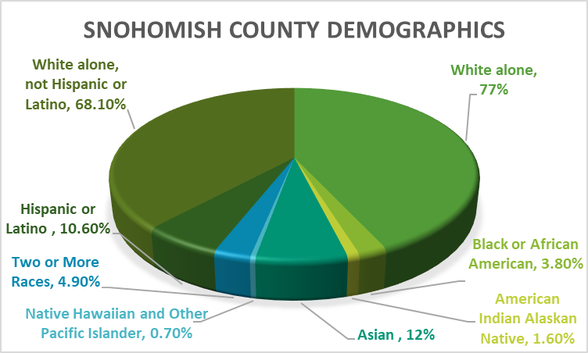
Summary of the West African Community
20,000 West Africans live and work in Washington State²
Majority immigrant and undocumented community²
Large proportion of the community is employed in the food and hospitality industries as well as in health care facilities – front line workers²
High proficiency in West African languages²
In Snohomish County, 7.1% of persons live in poverty³
Figure 1: Demographics of Snohomish County created from Census Data ³
Notes:
Talk about the pie chart, mainly whites who live in Snohomish county. Also, point out that the WAC would be categorized under Black or African American and they make up 3.8% of Snohomish County’s population.
Talk about the information found on the WAWAC site that is specifically about the WAC
Point out the percentage of people living in poverty in Snohomish County

Slide 4
WAWAC Community Assets²
Transportation Services
Bill Payment & Grocery Assistance
Interpretation & Translation Services
Adult Literacy Programs
After School Program
Notes:
Discuss these 5 services that WAWAC offers
WAWAC only has 1 van that fits 15 passengers that WAWAC uses to take community members to vaccine appointments and other commitments like interviews, medical appointments, take their children to and from school.
WAWAC’s bill repayment program focuses on supporting immigrants, refugees and new members of the community who are struggling financially, however, members must apply for this assistance
Interpretation and Translation services are provided by WAWAC because a majority of WAC members are English second language learners and interpreting important and sensitive information can be challenging. Adult literacy programs are also spearheaded by WAWAC in order to address the language barriers WAC members experience
Lastly, the after-school program organizes engaging programs for the children of the community.
Mention how despite having these resources funding is limited and can’t support the needs of all WAC members

Slide 5
Overview of the Assessment Plan
Overarching Questions
  Why has COVID-19 vaccination among the West African Community been lower than that of the larger Snohomish County population?
  What factors are driving the low vaccine uptake in the West African Community in Snohomish County?
  How can COVID-19 vaccine uptake be improved?
Scope of the Assessment
Purpose: Identify barriers, facilitators, and existing community assets in the West African community contributing to the low uptake of COVID vaccination
How will you involve the community: Key informant and secondary research
Who will use the results: West African Community and local public health authorities
Methods
  Root Cause Analysis
  Formative Research & Secondary Data Analysis
  Primary Data Collection with Key Informant Interview
Time Frame
10 weeks
March June
Notes:
This community health assessment seeks to answer these 3 overarching questions to get to the root cause of low COVID-19 vaccine uptake in Snohomish county by West African community members.
This project aims to be inclusive of West African voices and stories and they are the drivers of this assessment
The methods through which we developed this community health assessment were through group collaboration during the root cause analysis and secondary data collection process. As a group, we collected sources and gathered information surrounding COVID-19 topics in Snohomish county and scoured the web looking for sources that directly talked about the WAC. This led up to an interview with community member Pa Ousman Joof where we got to ask a prominent member of the community who has been actively involved in assisting the WAC prior to and during the pandemic.
This project was all accomplished in the course of 10 weeks.

Slide 6
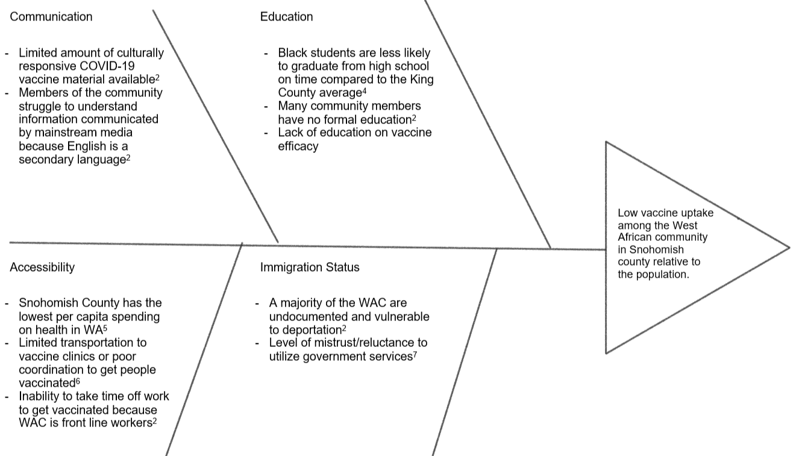
Root Cause Analysis of Low vaccine uptake in WAC in Snohomish county
Notes:
To get to the root cause of the low vaccine uptake in the WAC in Snohomish county 4 factors were identified as contributing to this
Language barriers pose a significant barrier for the West African community as English second language learners and therefore makes navigating health information difficult, especially in the era of COVID-19.
Educational barriers such as a lack of formal education and late graduation impact the economic outcomes of families. This also affects job opportunities in the future.
The job opportunities that exist for West African community members are mainly in the hospitality and food industry—frontline workers– which makes it difficult to get time off work. In addition, WAWAC is working with only ONE 15-passenger van to make transportation accommodations to vaccine appointments which makes accessibility difficult.
Lastly, the majority of the WAC are undocumented and vulnerable to deportation. Due to misconceptions as well as the U.S. harsh immigration policy, immigrants are reluctant to utilize government services. These are all barriers exacerbating the low uptake of the COVID-19 vaccine.

Slide 7
Community Engagement Strategies
Key Informant Interview
Collection of Qualitative Research
Formative research to learn more about the community and develop an understanding of community needs
Utilizing secondary data to gather quantitative data
Notes:
The main way our CHA was community-centered and CBPR was through the inclusion of the community throughout all aspects of our project.
The project began with formative research to gain an understand of the community we would be partnering with this quarter. We identified assets that already existed in the community as well as what the community themselves described as community needs.
Then we scoured the web searching for quantitative data about our community
And ended with the collection of qualitative research directly from a prominent figure within the West African community, Pa Ousman Joof.
This all was done in preparation for our Key Informant interview.

Slide 8
Summary of Secondary research
Methods
  Search for Snohomish County-specific data about COVID-19 trends and vaccination coverage
  Utilize UW libraries and Boolean search terms which included various combinations of “West African Community,” “COVID-19 Vaccination,” and “Snohomish County” to find relevant research articles
  Search the Washington West African Center’s website for information regarding the community and information about COVID-19
Limitations
  No research or specific secondary data exists on COVID-19 trends or vaccination rates among the W. African Community in Snohomish County
  Data found was typically stratified by race and not specific to the West African Community
  Limited number of sources to pull information from
Notes:
The main method for searching for secondary data was through the use of key words that included “West African” and “Snohomish County” and “COVID-19.” However, no information specifically about the WAC was able to be pulled from these sources. Most data that we found was about Black or African Americans but never specifically about West Africans.
WAWAC’s website was a great source to learn about the needs of the community and the resources that exist to assist the WAC.

Slide 9
Summary of Secondary Research
Snohomish county was ranked as the 3rd county in Washington with more COVID-19 reported cases⁵
  166,413 total confirmed cases of COVID-19⁸
Blacks have significantly higher rates of COVID-19 infection compared to Caucasians.⁵
Snohomish county has the lowest per capita spending on health in the state at $19.8 ⁵
In Snohomish County, 3% (4980) of the Black population has completed COVID-19 vaccination
Notes:
Here are examples of quantitative data that was collected. As you can see, most of the information found was either county-specific or race-specific. Although West Africans are group under the same category as “Black or African American,” we can still use this data to get an idea of what COVID vaccination is looking like for the WAC.
We also see concerning trends in the county-specific data such as Snohomish county being ranked 3rd in the state for the most COVID-19 reported cases and that Snohomish county has the lowest per capita spending on health in the state.

Slide 10

methods for Primary Data Collection
Collaborate with Critical Peer Group to develop a series of open-ended questions for the Key Informant to address and used probing strategies to get information to answer all questions
Key Informant was invited to meet with our Critical Peer Group through Zoom where we interviewed the Key Informant about their experience with the West African community and COVID-19 as well as other community health problems
List of questions the Key Informant was asked are listed in the appendix of this presentation
Notes:
The preparation for our primary data collection was to collaborate with our CPG to formulate a series of organized, open-ended questions to ask our key informant in order to gain a better understanding of what is happening in the community.
Our key informant Pa Ousman Joof, was invited to join us through Zoom and spent an hour conversing with us and answering all of our questions. His perspective corroborated the information we had found in our secondary data search but also introduced new ideas about other issues facing the community.

Slide 11
Primary Data Collection
Misinformation
“If you take the COVID vaccine, you will turn into a zombie in a couple of months”
Interpersonal communication channels, like WhatsApp, have been used as a way to spread misinformation about COVID-19 vaccinations
Representation
“We do not see ourselves in your wonderful plan”
Pa Ousman is the reason why the first 1000 COVID-19 vaccines went to the BIPOC community. Through his advocacy and ability to speak up for the community during a town hall meeting, the county reconsidered where the first doses of the vaccine would be going.
Funding
“There is plenty of funding available, but it needs to be more accessible to WAWAC”
Obtaining funding for WAWAC is difficult because of the restricted nature of federal funding
WAWAC are used as advisors, but also need to be included in the decision making and resource distribution process
Funding that is available is unusable to WAWAC because the way the money can be used is restricted
Hear what we have to say, give us unrestricted support, strengthen the support already being provided
Need for culturally appropriate public health information (clear information presented in appropriate languages)
(P. Ousman Joof, Personal Communication, May 11, 2022)
Notes:
Pa Ousman confirmed that misinformation was impacting vaccination uptake in the WAC. He reported that WhatsApp was a big source of misinformation for the community since it was being used to spread untrue claims about the side effects of the vaccine. This highlights the need for culturally appropriate public health information to be disseminated to the West African community in their preferred languages in order to combat misinformation.
During our interview we also learned about Pa Ousman’s efforts to direct the first 1000 doses of the vaccine to the BIPOC community. Originally, all doses were going to seniors in assisted living facilities. Pa Ousman stood up and asked about the vulnerable seniors in the BIPOC community who don’t live in assisted living facilities and what would be done about them, when would they be able to receive the vaccine? This comment caused the county to reconsider and this is how the first 1000 doses went to the BIPOC community.

Slide 12
Data Analysis plan
After the Key Informant interview, we used the primary data we collected to contextualize the secondary data findings
Reflection Exercise to reflect on what we learned
Develop a Socioecological Health model with broad goals/objectives and an Action Plan to address the 5 Gaps
Identified 5 Community Health Gaps to be addressed
Notes:
After our key informant interview, we reflected on the data we collected and contextualized our findings. We saw what information was corroborated by our key informant and what new information we learned.
Next, we identified the top 5 community health gaps that needed to be addressed
Lastly, we developed a socio-ecological model with broad objectives and goals based on the 5 gaps we identified. Ultimately, we created a detailed Action Plan with specific objectives, goals, actors and time frames to achieve these goals.

Slide 13
Socio-ecological model
Build a permanent location for a community center for the WAC within 5 years
Improve English proficiency of older community members by 25% through hosting free ESL classes over the course of 5 years
Ensure that all DOH public health information disseminated to WAC is available in their native languages
Policy/Societal
Eliminate restrictions on funding to make funds more accessible for WAWAC
Improve the WAC’s understanding of immigrant rights and access to health care
Community
Include more West African stakeholders in public health positions/discussions
Interpersonal
Reduce the amount of COVID-19 misinformation being spread through interpersonal networks
Individual
Get community members to set up reminders to schedule follow up vaccine appointments and additional booster shots
Have important community leaders promote COVID-19 vaccination
Notes:
At the policy/societal level, our broad goals were to ensure public health information was being disseminated to the WAC in their preferred languages, eliminate funding restrictions, and include more West African stakeholders in public health positions.
At the community level we want to establish a permanent location for a community center within the next 5 years, we want to improve English proficiency in the older community, and improve the community’s understanding of immigrant rights and access to health care
At the interpersonal level we want to reduce the amount of COVID-19 misinformation being spread interpersonally, and encourage important community leaders to promote COVID vaccination
Lastly, at the individual level, we want community members to set reminders to schedule follow-up appointments for their second and booter shots.

Slide 14
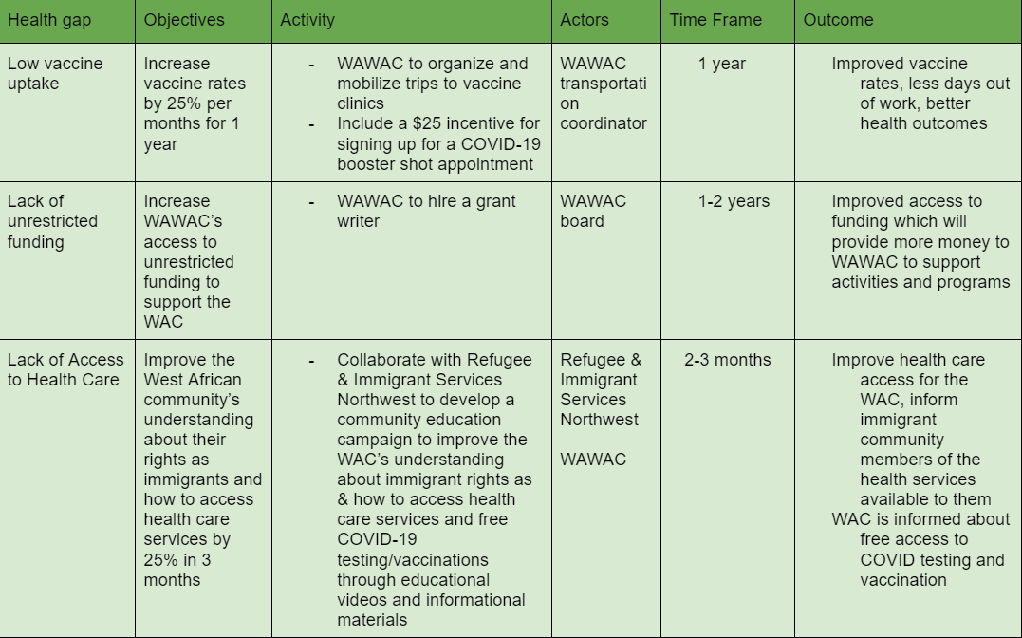
Action Plan I
Health Gaps
Low Vaccine Uptake
Lack of Unrestricted Funding
Lack of Access to Health Care
Lack of Community gathering space
Language Barriers in Accessing Health Information
Notes:
Based on the 5 health gaps identified after the interview, this action plan was developed to address these gaps.
First we have the low vaccine uptake, I believe the most important step here is to continue the current efforts but also incentivize signing up for the booster shots.
The next important gap is lack of unrestricted funding, I believe the best way to improve WAWAC’s current funding situation is to hire a grant writer to optimize the funding available.
The third is access to health care, for this a collaborative effort is needed. An educational campaign with collaboration from WAWAC and Refugee & Immigrant Services Northwest would greatly improve the WAC’s understanding of immigrant rights and access to health care.

Slide 15
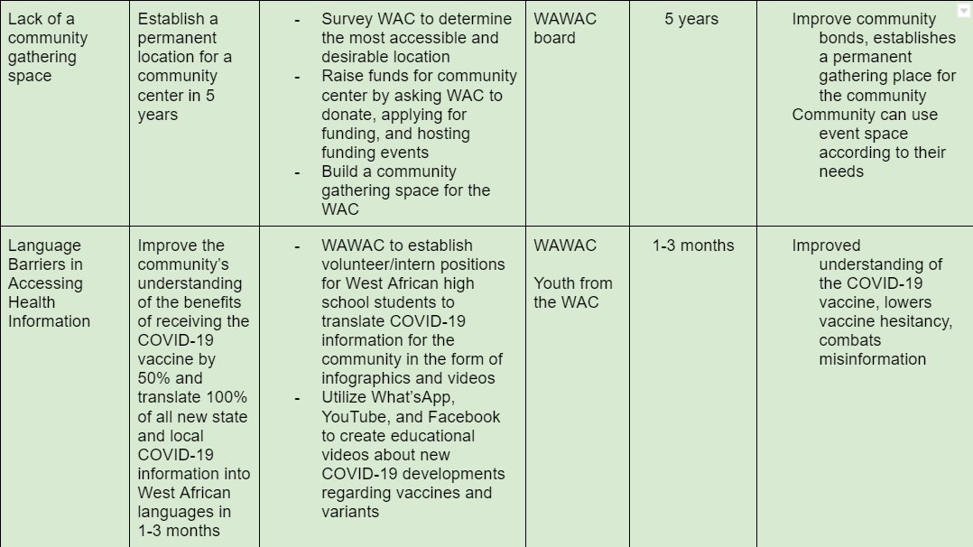
Action Plan II
Health Gaps
Low Vaccine Uptake
Lack of Unrestricted Funding
Lack of Access to Health Care
Lack of Community gathering space
Language Barriers in Accessing Health Information
Notes:
Our next gap is the lack of a community space, this is a need that Pa Ousman expressed during the interview. Our goal is to establish this in the next 5 years
Lastly, to address the Language barriers in accessing health information, I propose an internship position for high school students to translate COVID-19 information from DOH for the West African community and also to create educational health videos for the community.

Slide 16
Dissemination plan
West African Community
Create & print brochures detailing the findings of the community health assessment in clear language
WAWAC & other stakeholders
Present findings to WAWAC & partners at the next conference
Hold community meetings to review findings for community members to ask questions
Seek feedback
Set up future meetings to ensure Action Plan and goals are being worked towards
Notes:
To disseminate the findings of this CHA, it is of the utmost importance that we make sure the West African community knows about our findings since they are the focus of this plan. Therefore, we intend to create and print brochures detailing our findings in the preferred languages of the community and in addition hold community meetings to discuss the findings. We will create a space for the community to ask any question they need.
It is also important that we share our findings with WAWAC since this project would not be possible without the contributions of Pa Ousman. WAWAC’s website was also an integral source of knowledge that taught us a lot about the WAC. Therefore, we want to present this presentation to WAWAC and their partners at the next conference. We also want to set up future meetings to ensure that Action plan is being worked towards.

Slide 17
Sources
CDC. (2020, March 28). COVID Data Tracker. Centers for Disease Control and Prevention. https://covid.cdc.gov/covid-data-tracker/#county-view?list_select_state=Washington&data-type=CommunityLevels&list_select_county=53061
Washington West African Center. (n.d.). About WAWAC – Washington West African Center (WAWAC). https://wawac.org/about-wawac/
U.S. Census Bureau. (2021). QuickFacts Snohomish County, Washington. https://www.census.gov/quickfacts/fact/table/snohomishcountywashington/RHI225220
Communities Count. (n.d.). On Time High School Graduation. https://www.communitiescount.org/on-time-high-school-graduation
Carrera Zamanillo, I. (2021, February). COVID-19 Gap Analysis an initial glimpse at Washington State. Front and Centered. https://frontandcentered.org/wp-content/uploads/2021/02/FC-COVID-19-Gap-Analysis.pdf
Joof, P. O. (2022, March 19). More vaccine slots for West Africans in Washington – Washington West African Center (WAWAC). Washington West African Center. https://wawac.org/more-vaccine-slots-for-west-africans-in-washington/
Haq, C., Hostetter, I., Zavala, L., & Mayorga, J. (2020). Immigrant Health and Changes to the Public-Charge Rule: Family Physicians' Response. Annals of family medicine, 18(5), 458–460. https://doi.org/10.1370/afm.2572
SparkMap. (2022, May 25). Standard Report for Snohomish County. https://sparkmap.org/report/
Washington State Department of Health. (2021, April). COVID-19 Vaccination Coverage by Race and Ethnicity in Washington State Counties. https://doh.wa.gov/sites/default/files/2022-03/348-805-COVID-19VaccinationCoverageRaceEthnicityWashingtonStateCounties.pdf?uid=6262f90b154ff
(P. Ousman Joof, Personal Communication, May 11, 2022)

Slide 18
Appendix
Key Informant Questions
We know that you are an important pillar of the West African Community, what would you say are the most pressing health concerns facing the West African community?
Is there a particular group of people in your community that is disproportionately affected by these issues? Why do you think this is?
We understand from our research that there is low vaccine uptake among the West African Community in Snohomish county, is this what you’re observing or something else?
What is the community’s general perception of vaccination?
  Are you seeing differences in vaccination among age groups, sex, occupation?
What barriers have you observed exacerbating low vaccine uptake?
  How can this be addressed? What support do you need?
Based on some of the data we’ve collected, we found that immigration status may pose a barrier to accessing healthcare; in what ways has this affected vaccine uptake in the West African community?
  Is this a concern that you are seeing, and if so, how can we appropriately address these concerns in the West African community?
One of the challenges identified by the community is access to firsthand information in native languages, due in part to most of these languages not being written. How have you seen this issue play out throughout the pandemic, specifically in regard to vaccine information and how has public health tried to rectify this information disparity?
Do you see that there is active communication among public health officials and your community
How is the level of communication between public health officials and your community in response to the low vaccine uptake?
What are your suggestions for public health officials to improve communication with the West African community?
How do you feel your past roles as a journalist, public speaker, and interpreter (among others) have helped you connect with the West African Community?
We observed that WAWAC has organized several vaccine clinics, how effective have these clinics been at improving vaccination rates among the West African community?
How effective have WAWAC programs, like the transportation services, been in terms of providing more access to resources?
  What other community assets or services exist to support the West African community?
How is information about COVID-19 vaccines & other community events being distributed to the community? What is the most effective way to reach community members?
What positive changes do you hope to see between the West African community and the health care system in the near future?

