Slide 1
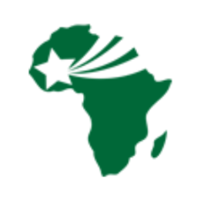

Snohomish County:
A Community Health Assessment
Maddy Agranoff
HSERV 345, 2022
**Insert pics here !
Notes:
Introduce name, location, purpose
Conducted as part of a HSERV 345 class assessment
Give segue to next slide by saying you will touch more on the problem your CHA will address

Slide 2
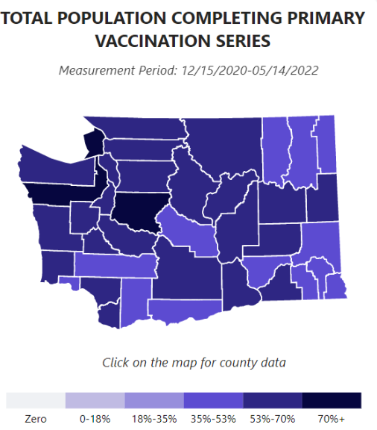
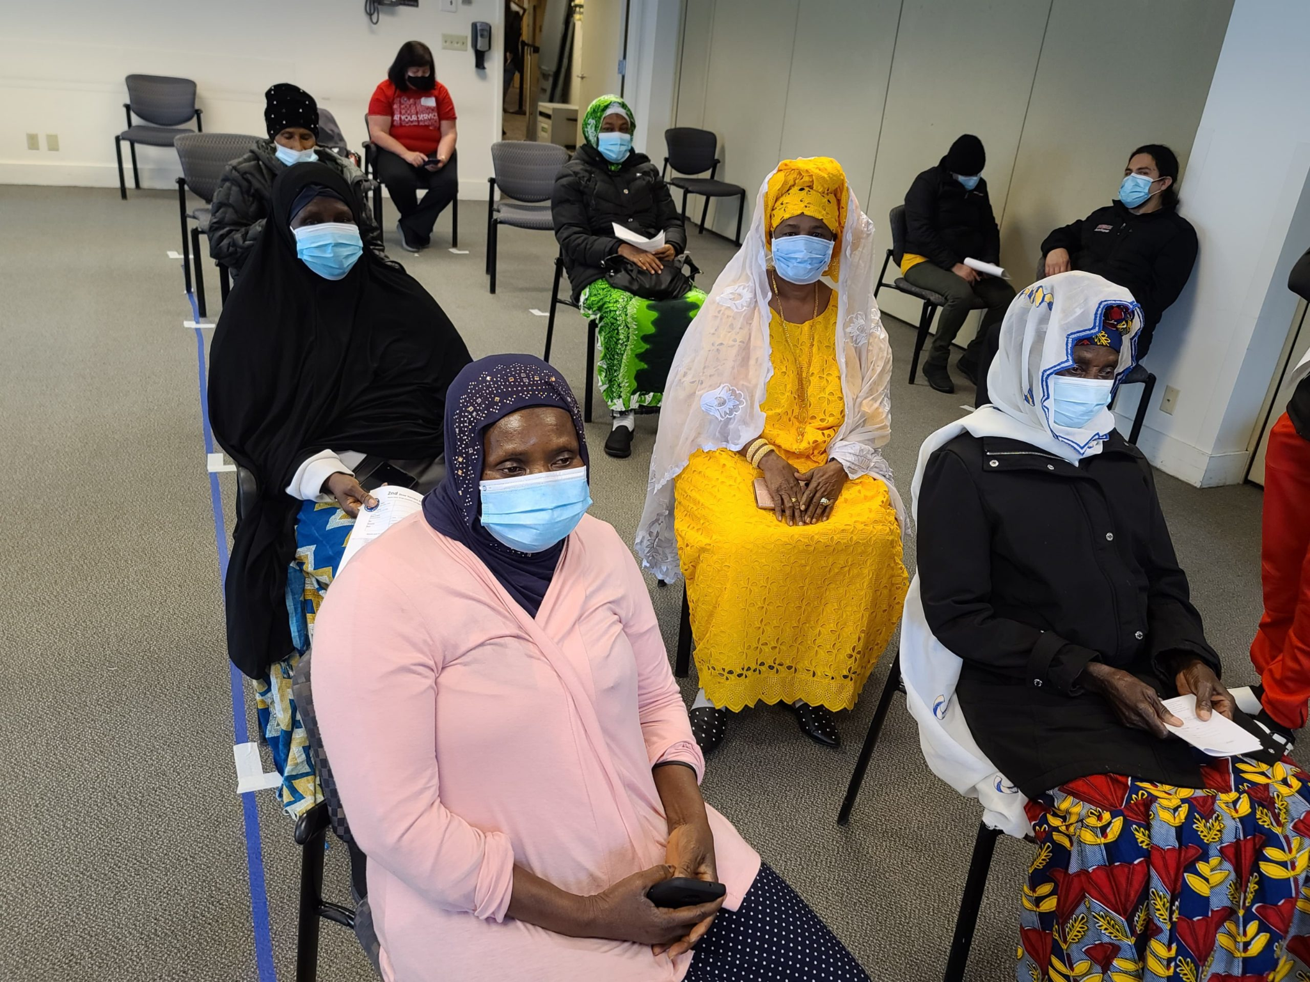
Summary of the Problem
70.8% of Snohomish County population fully vaccinated, compared to 96% of WA state (CDC, 2022).
West African Community exhibit lower rates of vaccine uptake compared to their White counterparts (SHD, n.d.).
  Women and children especially susceptible to COVID-19 within the WAC (Pa Ousman, 2022).
Notes:
Talk about how vaccine uptake lower in SnoCo than WA (CDC COVID-19 dashboard + SHD data)
KI Pa Ousman revealed women + children especially susceptible to COVID
Address relevance of stats to overarching problem + root causes

Slide 3
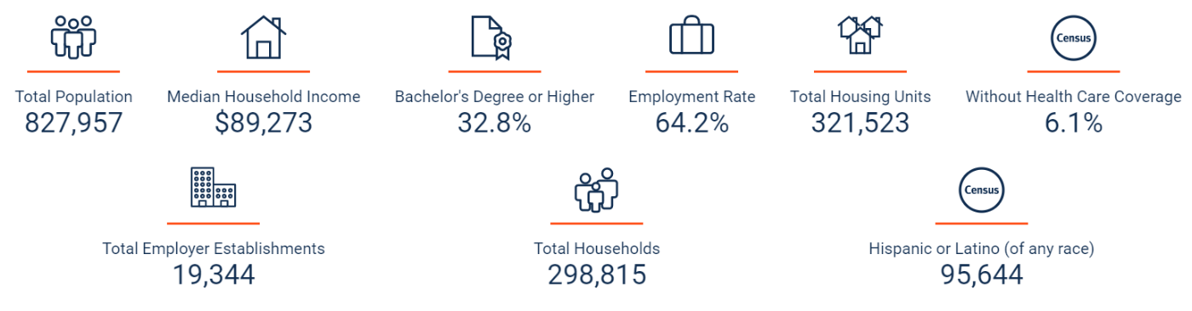
West African Community Summary (WAWAC, n.d.).
20,000+ West Africans in WA state
Immigrant community that spans individuals from The Gambia, Senegal, Mali, Mauritania, Sierra Leone, Ghana, Nigeria, Togo, Guinea, Burkina Faso, Côte d'Ivoire, and Benin
Majority of WAC member occupations in hospitality, front-line work
Within Snohomish County (U.S. Census Bureau, 2021):
  22% speak a language other than English at home
  17% “foreign born persons”
  Per-capita income lower in Snohomish County compared to rest of WA state
Notes:
Touch on how WAC population has and continues to grow in SnoCo
Touch on how these hospitality roles included frontline work during COVID
Almost 1 in 4 people in SnoCo speak a language other than English at home, moreso for those within the WAC (set foundation for need for culturally appropriate health communications in multiple languages)

Slide 4
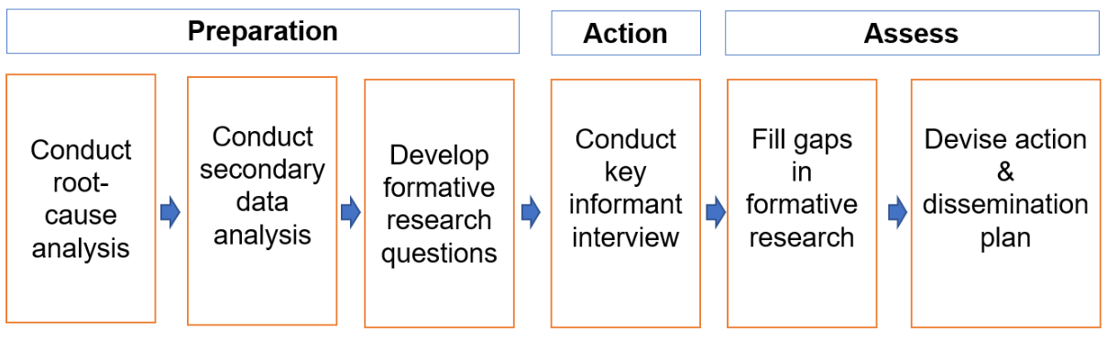
High-Level Overview of Assessment Plan
Questions addressed:
Why is vaccine uptake lower in the West African Community relative to the rest of the Snohomish County population?
What are the underlying factors, barriers, and facilitators to achieving improved vaccine uptake and health equity in the WAC?
Assessment Methods
Root Cause Analysis
Formative Research Collection & Secondary Data Analysis
Key Informant Interview
Assessment Scope: April → May 2022
Notes:
Touch on main questions addressed + why
Briefly explain each assessment method used and in what order according to assessment scope
Note that scope of assessment ends at assessment stage, not implementation stage

Slide 5
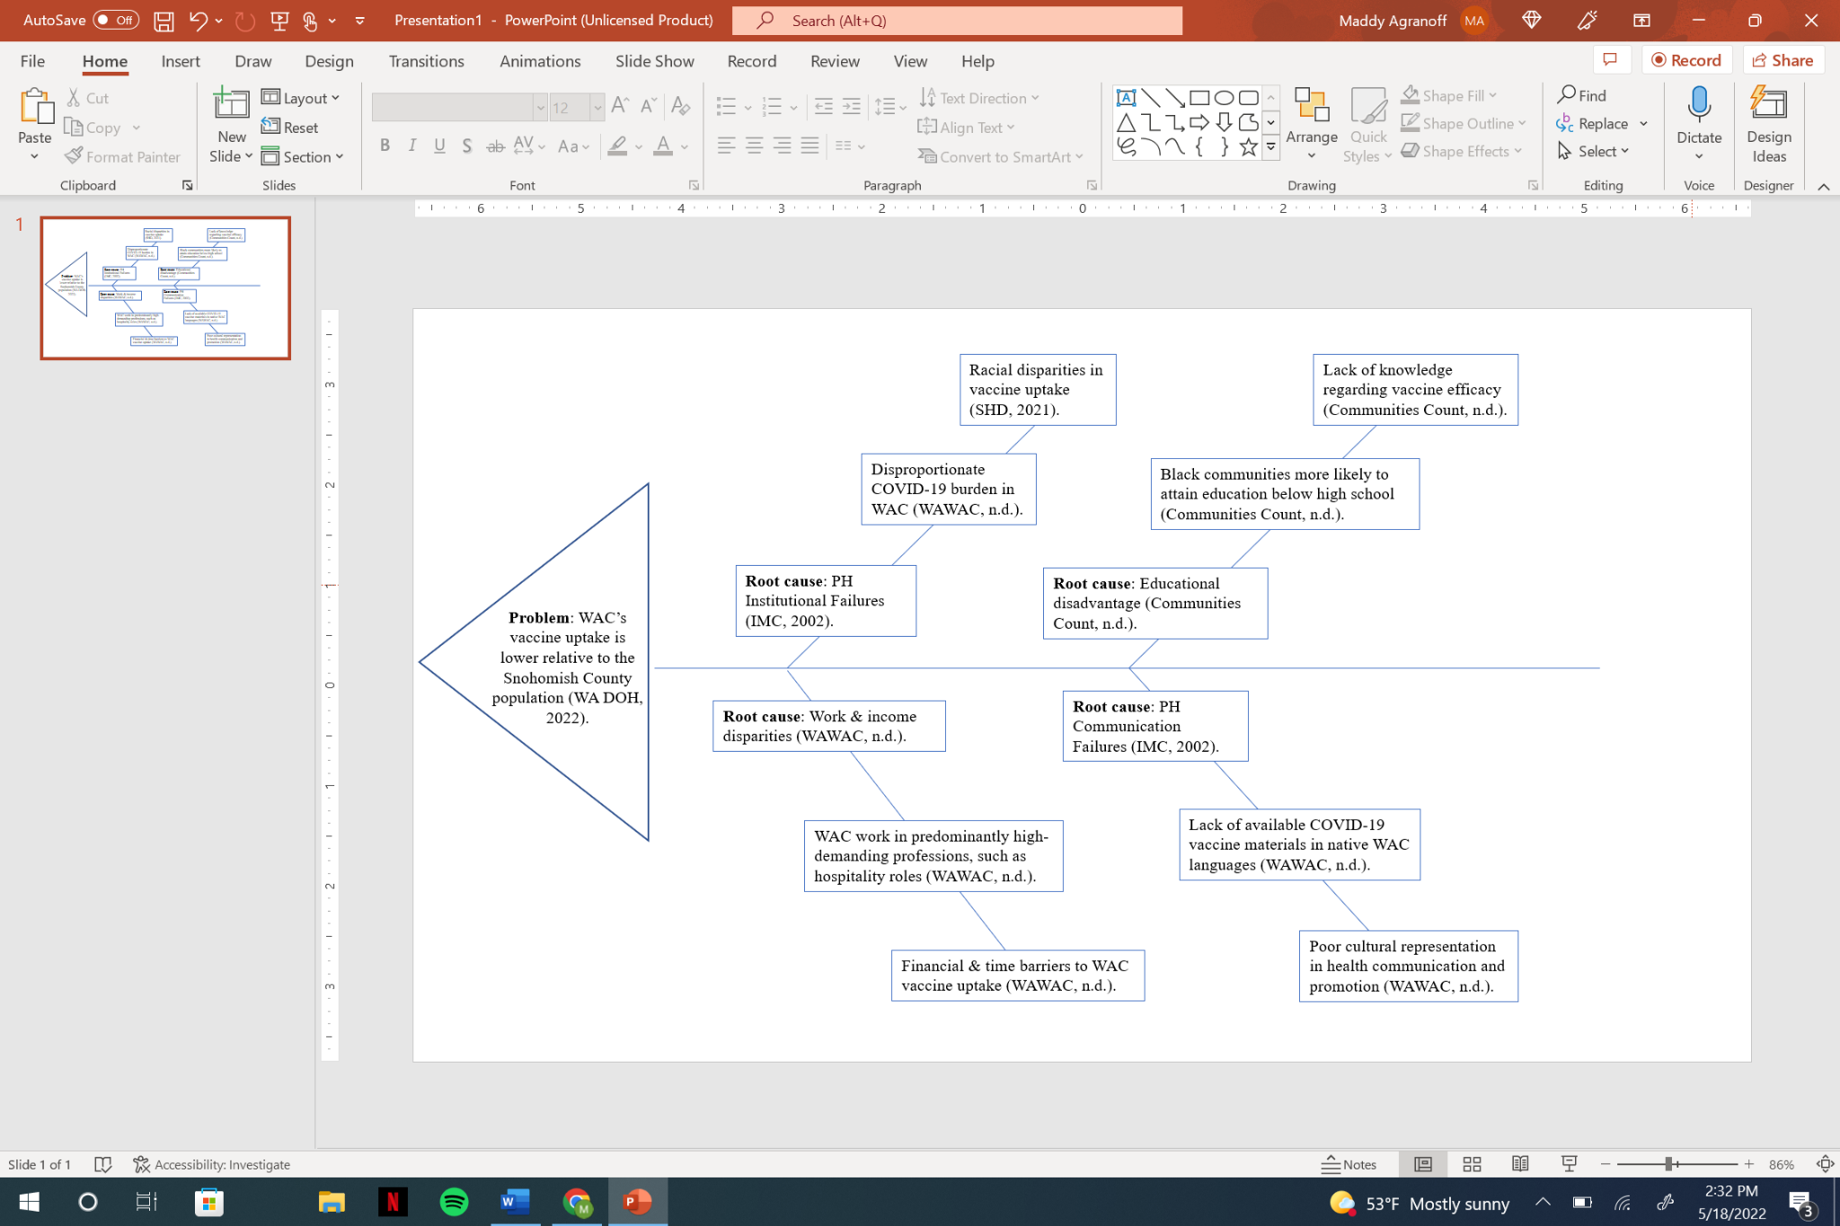
Root Cause Analysis
*PH = Public Health
Notes:
Talk about 4 main root causes + how they contribute to low vaccine uptake in WAC specifically
Clarify root cause analysis was done in formative research phase, before speaking with KI
Emphasize that most of the root causes are the result of systemic inequities, not individual failures

Slide 6
Secondary Data Summary & Findings
Methods
Seek out as secondary sources that address County-level-specific data, such as Communities Count.
Search relevant keywords in the search engines of secondary sources (e.g., “West African,” “COVID-19,” “vaccine uptake,” etc.).
Only pull data that will help to address root causes of the problem.
Findings
% of individuals with a first booster dose in SnoCo lowest among those at or below 12 years of age (CDC Wonder, 2022).
70.8% of SnoCo is fully vaccinated, compared to 96% of entire WA state (CDC, 2022).
Black communities more likely to fall 200% below the poverty line, attain education below high school, and have poorer health outcomes compared to white populations (Communities Count, n.d.).
WA black caregivers more likely to lack daily support with raising children
SnoCo COVID-19 case rate of 95.85 people per 100,000 (CDC Wonder, 2022).
Limitations
No existing secondary data on the West African Community found in SnoCo, or WA state as a whole
Had to use data on black populations within SnoCo to generalize to the WAC
Most secondary data pulled from 2-3 sources
Some King County data generalized to SnoCo
Notes:
Briefly explain methods section - noting most sources came from Communities Count + CDC Wonder
Note that this occurred as part of formative research stage
Emphasize how limitations of findings show a gap in WAC-centered research
Segue from secondary data methods → primary data methods in next slide

Slide 7
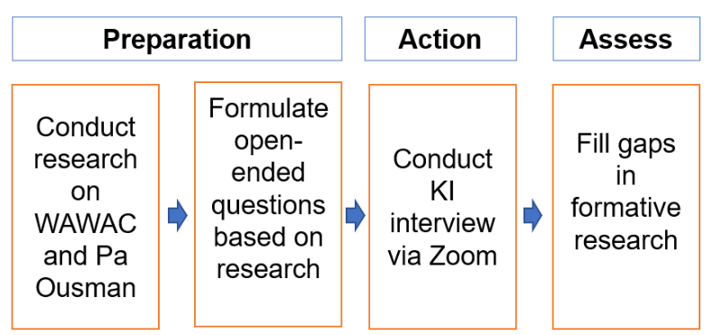
Primary Data Collection Plan: Key Informant Interview w/Pa Ousman
Methods
“All these great ideas we have…we never have any funding or support to do it. [I’m] using my own van that I’m sitting in right now to provide services.” - Pa Ousman
Notes:
Note that the primary data collection tool chosen was through a key informant interview approach in order to fill gaps in secondary data collection
Note that one of the primary concerns mentioned by Pa Ousman was a lack of WAWAC funding, as detailed in the quote provided
Mention that the full audio of the interview and complete KI questions and answers will be available in the appendix

Slide 8

Community Engagement Strategies: Key Informant Interview w/Pa Ousman
1) Accessible Outreach Channels:
Reached out to community members within the WAC by email to invite them to participate in a key informant interview
3) Consultative Community Engagement Strategy:
Consulted with WAC key informant, Pa Ousman via Zoom in a formalized, qualitative interview
Meeting used to gather feedback on formative research findings
Used Pa’s feedback to critically assess alignment & potential gaps in our research
2) CBPR Approach - Primary Data Collection
with Pa Ousman:
Invited Pa Ousman to take on a researcher role in our primary data collection process to identify health gaps in the WAC and garner community-centered input
Notes:
Emphasize collaboration & CBPR approach in community engagement strategies
Note that Pa played a crucial role as both a researcher and participant to help fill gaps in our formative research
Helped us to foster mutual understanding (tenet of CBPR) of WAC needs, facilitators, and barriers to low vaccine uptake
Provide segue into what Pa helped to identify for us in terms of community assets + gaps to be addressed in the next couple of slides

Slide 9
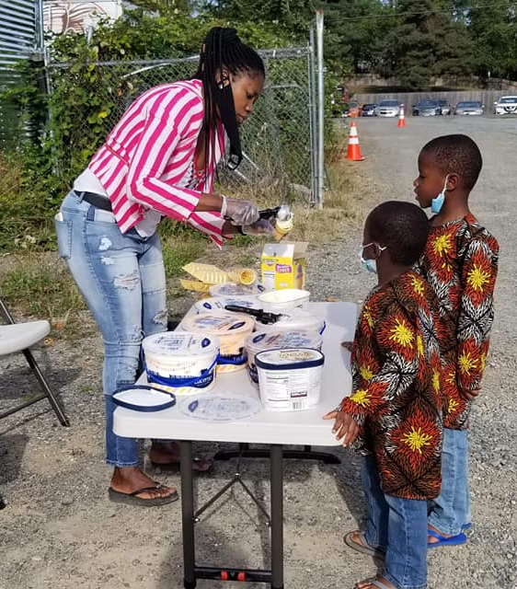
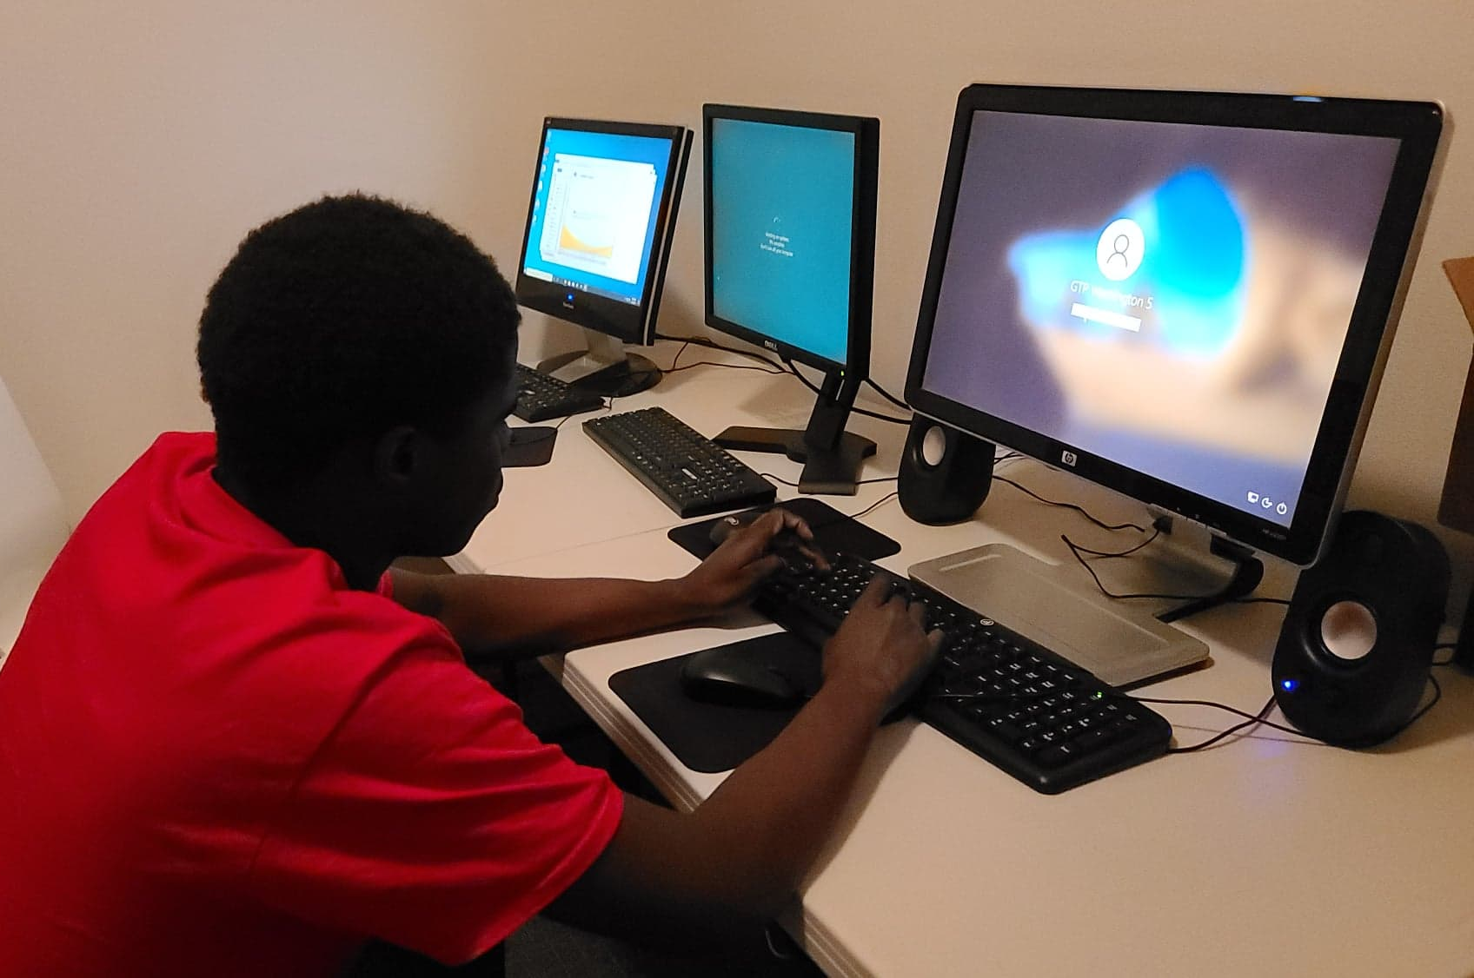
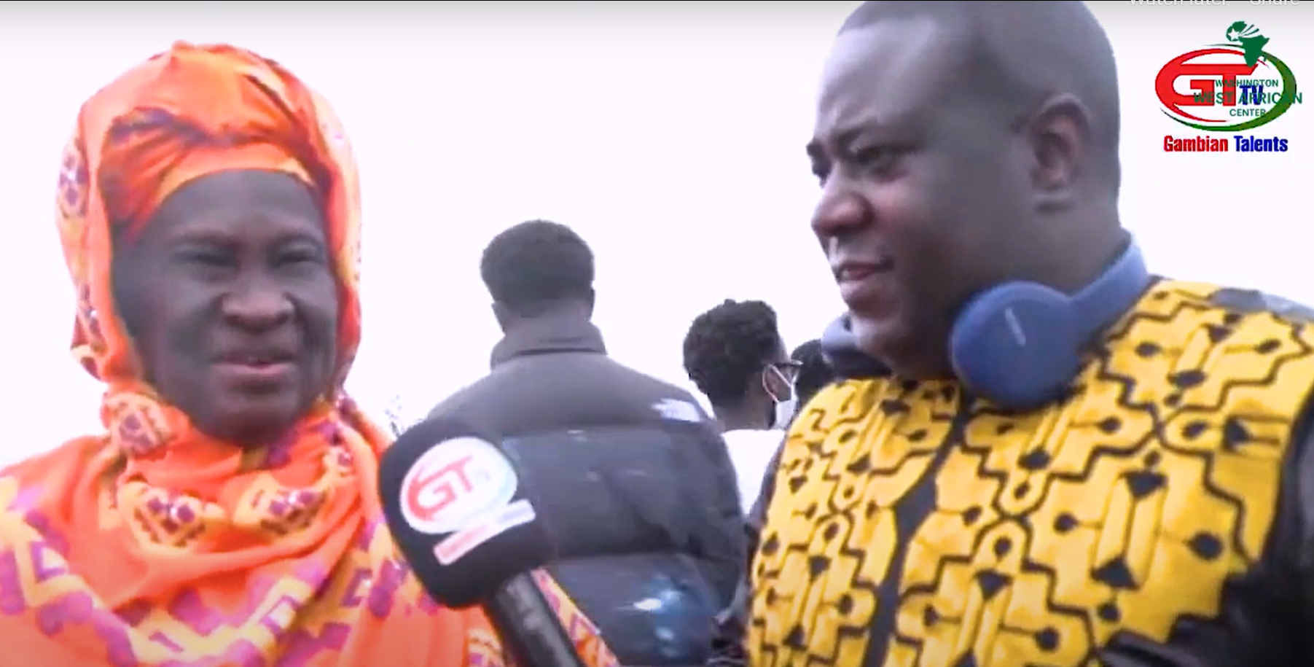
Community Assets: WAWAC Snapshot (WAWAC, n.d.).
Transportation Support Services
COVID-19 Testing
Grocery Assistance
Marriage Counseling Services
After-School Programs
Clothing Drives
…and much more!
Notes:
Highlight the main services provided by WAWAC according to their website + interview w/Pa Ousman
Touch on additional community assets outside of WAWAC, including Snohomish Health District, local parks such as Ferguson Park, and Sno-Isle Libraries
Emphasize that there is much more that WAWAC does beyond this slide that helps to build community resilience and fill the health gaps discussed so far

Slide 10
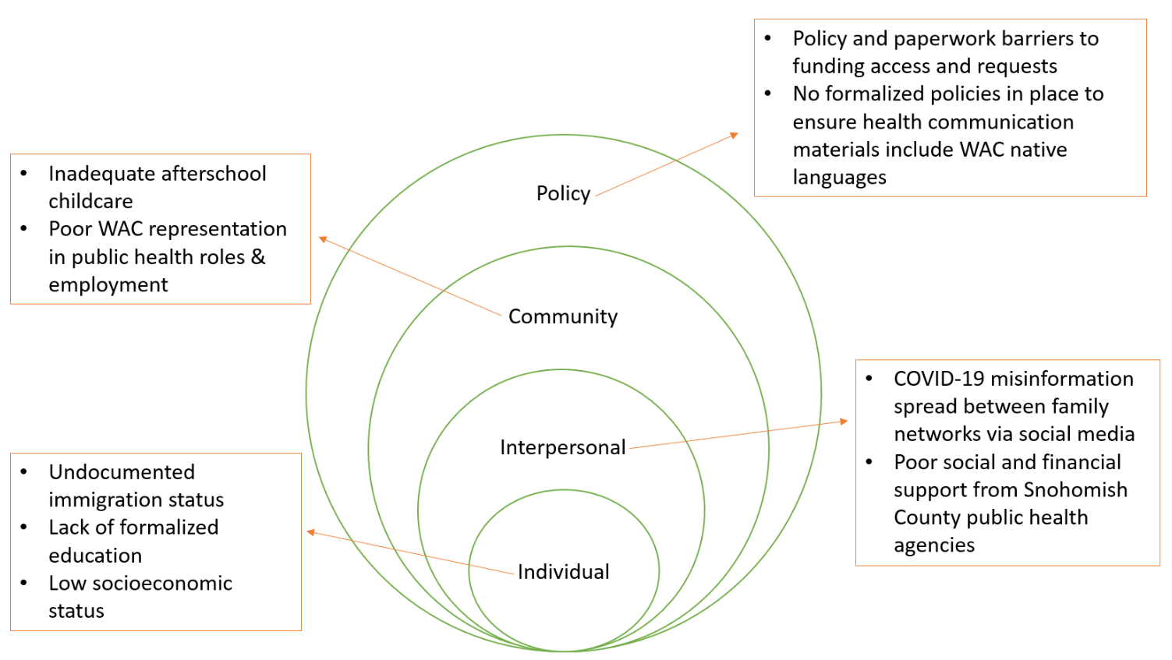
Social-Ecological Model based on Key Informant Interview with Pa Ousman
Notes:
Talk about how these needs will be addressed later through a detailed action plan (part of the data analysis plan)
Discuss that these needs were identified by KI, Pa Ousman + warrant attention in this CHA
Discuss how the needs differed from formative research findings / helped us to narrow scope of specific barriers + facilitators to improved vaccine uptake in WAC

Slide 11
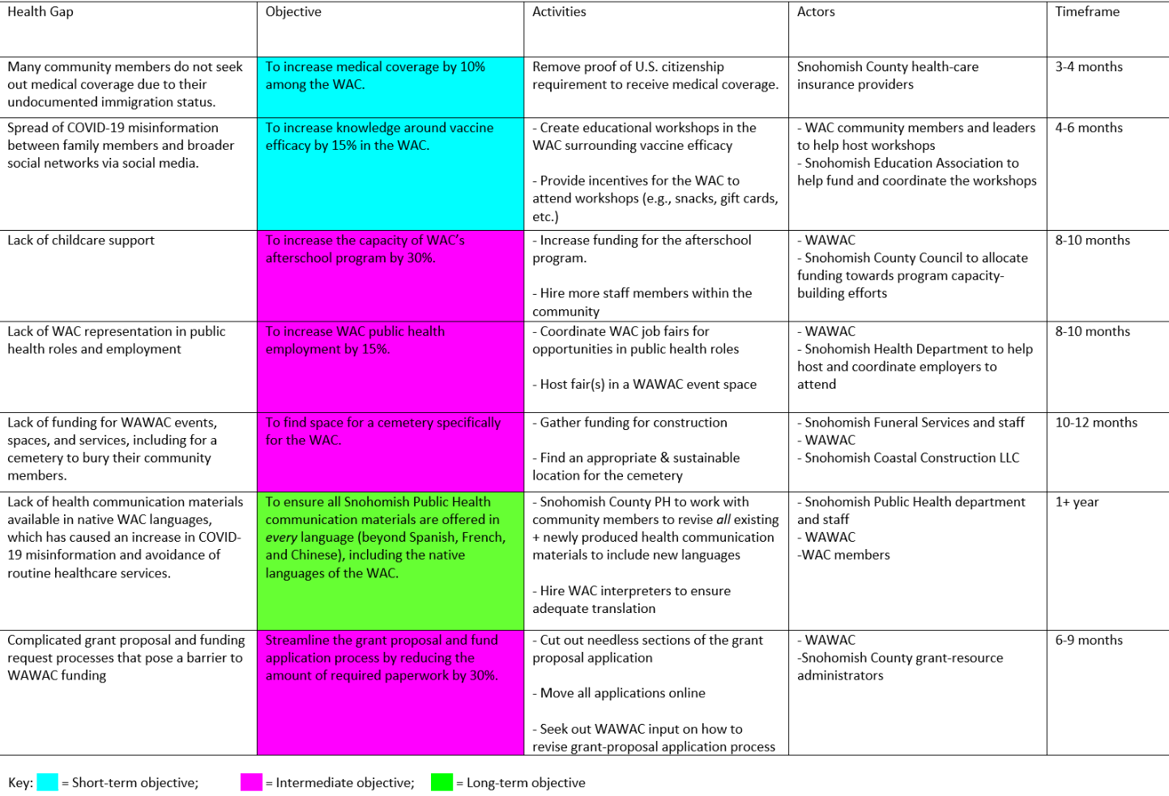
Action & Analysis
Plan
Notes:
Note that actors were pulled from community assets + gaps pulled from formative research (demonstrates how assessment findings were analyzed to create action plan)
Note that timeframes were not too long-term as to remain realistic + attainable
Discuss that health gaps informed by key informant interview + most gaps were found at community-level

Slide 12
“We are very resilient. We are building different networks and going out there, sitting at the table, making sure our voices are heard, and that is making a big difference.” - Pa Ousman
“
Notes:
Conclude presentation w/quote from Pa Ousman
Emphasize the resilience and community strength of WAWAC and WAC, especially in the navigation of COVID-19
End on an action-oriented note:
Remind audience that there’s still a lot more work to do in the community towards addressing low vaccine uptake, minimizing racial disparities, & achieving health equity

Slide 13
References
Communities Count. (n.d.). Health Disparities Dashboard. Retrieved May 20, 2022, from https://www.communitiescount.org/health-disparities-dashboard
Institute of Medicine (US) Committee on Assuring the Health of the Public in the 21st Century (2002). The Future of the Public's Health in the 21st Century. Washington (DC): National Academies Press (US); 3, The Governmental Public Health Infrastructure. https://www.ncbi.nlm.nih.gov/books/NBK221231/
Snohomish Health District (2021, November). Covid-19 Race/Ethnicity Data Analysis January 19, 2020 November 18, 2021. Snohomish Health District. Retrieved May 20, 2022, from https://www.snohd.org/DocumentCenter/View/8768/COVID-19_Race_Analysis_11-18
United States Census Bureau. (2020). QuickFacts: Snohomish County, Washington. Retrieved May 16th, 2022 from https://www.census.gov/quickfacts/snohomishcountywashington. Washington State Department of Health. (2022). Covid-19 Data Dashboard. Washington State Department of Health. Retrieved May 19, 2022, from https://doh.wa.gov/emergencies/covid-19/data-dashboard
Washington West African Center. (n.d.). About WAWAC. Washington West African Center (WAWAC). Retrieved May 17, 2022, from https://wawac.org/about-wawac/

Slide 14

Appendix
Full Key Informant Interview with Pa Ousman: Audio File Attached.
Key Informant Questions & Answers Link: https://drive.google.com/file/d/1p2b_Ja6jSWzSHZNYF6I8gPmLIvi8URDM/view?usp=sharing
Notes:
Click on volume icon to listen to the audio file.
Copy and paste link into browser to access KI Q&A.

