Slide 1
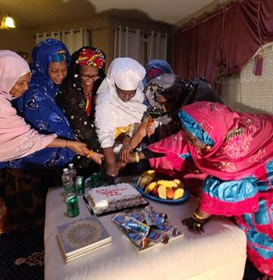
WAWAc cOMMUNITY SNOHOMISH wA
Community Health Assessment
Anfel Reza
Rabi Yunusa, Marwa Abdalla
HSERV 345, 2022
Notes:
Introduce yourself including name, date, class and year.
Introduction: say what the project is, location of this health assessment and the purpose.

Slide 2

Summary of Problem
Problem? The covid-19 vaccination uptake in the WAWAC community in Snohomish WA is low.
West Africans have low vaccine uptake compared to their white counterparts ₄
Who is the most Affected? In the community those that are women, senior or children are being the most affected by this low uptake ₆
CHA? Help identify the various gaps in the community including barriers that play a large role in having low vaccine uptake
in specifically the WAWAC
community.
Notes:
Talk about the problem of low vaccine uptake in the WAWAC community in Snohomish Wa
Talk about how this low vaccine uptake is lower in this race compared to other people.
Talk about how Pa Ousman (leader of community) said that women and children are mostly affected by this low vaccine uptake

Slide 3





Snohomish / WAWAC Community Demographics
Dominant Immigrant community ₁
Black/African Community ₁
30% fully vaccinated in the West African Community ₁₁
27% of population living in poverty in Snohomish₃
40% single parent household in Snohomish ₃
Notes:
Mention how this community is a majority immigrant population that spans from various African countries
Explain that many of these people are Black/African Race
Talk about the people that are fully vaccinated in the community and why people do not want to take the other doses (misconceptions!)
Talk about socioeconomic factors such as percentage of people that live in poverty in Snohomish Wa
Talk about percentage of single parent household in Snohomish Wa and how in the community raising children as a single parent is hard putting the parent in a tough situation to attend to their own health.

Slide 4

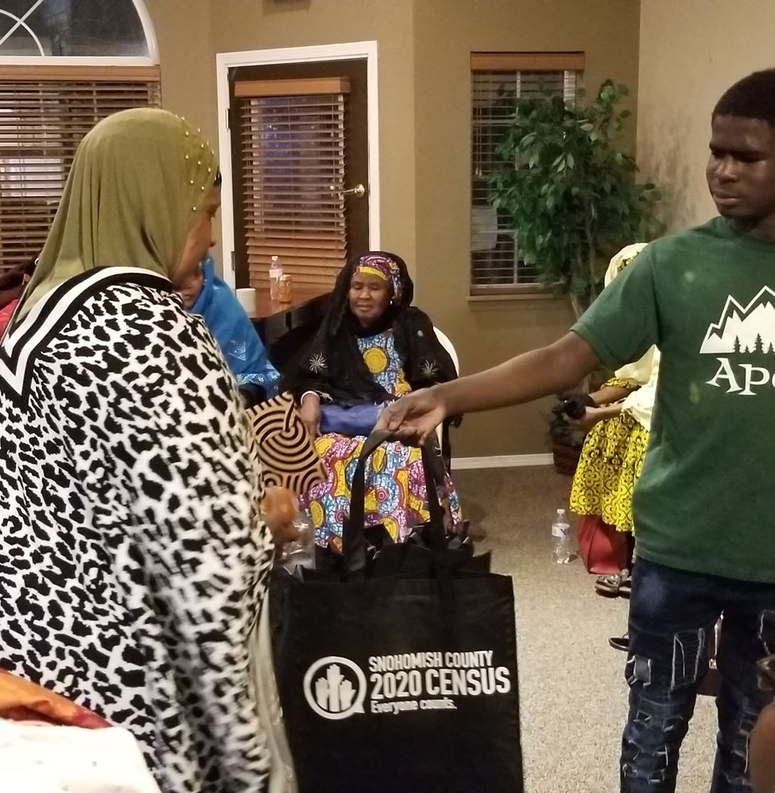

Summary of the Community ₁
WAWAC is serving home to over 20k West African in the state.
A culture that brings them together to help them strive.
Celebrate the diversity of the people and their culture; using food, color, music and more.
After school programs, childcare, knitting club, fresh produce given to the community, support groups.
Fundraising
Religious beliefes are important:
Religion teches to help eachother and give eachother a place to sleep if in need.
Health disparities since they are a minority group such as insurance, lack of care, burden of disease
Majority seniors with underlying health conditions
Notes:
Give insights of the community and how many people are part of that growing community
Talk about their religion and culture since it is a big part of their identity and how they live life
Mention various activities and after school programs
Mention the community health status and how many elders who live in this community have health conditions
Mention how these elders who have these health conditions are afraid that obtaining vaccine will make their condition worse.

Slide 5



Overview of Assessment Plan
Preparation, action, and assessment
WAWAC and vaccine hesitancy
Immigrant Status and effects on low uptake
Low health representatives in the community
Overarching Questions ?? :
What aspects specifically in the WAWAC community is contributing to the low covid-19 vaccination uptake?
How do these factors prevent community members from obtaining the vaccine?
The Scope of
the Assessment
Methods Used
Time Frame
Root Cause Analysis
Formative Research and secondary data analysis
Key informant interview (Pa Ousman)
10 weeks (April 2022 – June 2022
Notes:
Talk about the main questions that will be touched on throughout the CHA
Explain the Methods used and the important doings for each methods mentioned
Explain the scope of the assessment and the various phases; include that main key points mentioned. Note that this CHA stops at the assessment phase.
Briefly explain the time frame of the project.

Slide 6


Root Cause Analysis- Fish Bone
Environmental Factors
Health Care Access
No health representatives in the community that can help guide these people/ clear up any confusions ₂
Not many resources that are available in the community because of inequities, no implementation of strategies to assure for equitable access to services/ groups ₃
No collaboration between the community and the local government ³
Immigrant Status; afraid of deportation therefore they rather not risk it ₁
Many can believe that they need “health insurance” and don’t know that vaccination is free which allows them to avoid seeking health care facility ₁₀
Work conflicts-hard to take time off and must attend to their children (especially because the divorce rate is high in this community) ₁
Long distance to healthcare facility ³
Low uptake of Covid-19 vaccination among WAWAC Communitiy in Snohomish Wa
Cultural understanding of the vaccine differs ₅
Mistrust of the westernized medicine/techniques ⁹
Communication not being translated clearly; and symptoms experienced not being translated clearly ⁸
Negative experiences when accessing a healthcare due to their culture ₈
Non-English speakers and they only receive information in English ₁
language barrier caused confusing information and misunderstandings/misinformation ₁
Not knowing the importance of vaccine, or having negative insights about it ⁷
People with underlying medical conditions believe that taking vaccination is not safe for them ¹
Vaccine Hesitancy
Education
Notes:
Talk about the root cause analysis and why we make this fish bone
Mention how this root cause was established during the formative phase of research
Explain the 4 main root causes and how these 4 categories are the most important that contribute to the low vaccine uptake in the community
Go into each the categories and explain these various barriers

Slide 7

Description of Community Engaged Strategies
1. Formative
Research –
developed Q’S
and
researched)
2. Qualitative
research (in-depth research)
3.Community
Involvement
(Interview)
*Refer to appendix for questions
formed for formative research
Notes:
Mention the critical steps to keep the CHA community engaged
Talk about the steps taken for this project
Talk about each step and how they contributed to allow us to conduct our CHA

Slide 8
Summary of Secondary Data Research
Findings ₁
Methods
Transportation services
Advocacy efforts (leader that takes a large role in community)
Values in community includes: respect, diversity. Inclusiveness, and honesty
The West African culture
Immigrant status
Various programs such as “monthly grandmas hangout” and ”adult learning class”
Limitations
Researched the community using the WAWAC website
Went to other webistes to obtain demographics/covtid vaccination in the Snohomish County such as front and centered.
Looked at the various gaps that was missing adapted question and went to other websites to learn more about the West African community.
There is no specific information regarding the covid vaccination the in the WAWAC community
Secondary data pulled from only a few resoiurces.
Not enough information regarding the WAWAC community , information wasn’t specific to this community.
Notes:
Talk about how secondary data is already collected using primary data
Talk about the main findings of these secondary data sources
Go into the methods used when conducting the assessment into detail
Talk about various limitations and why is was hard to obtain the necessary data

Slide 9
Summary plan for Primary Data Collection
Who?
Key Informant Interview with the leader of the community (Pa Ousman Joof) answered some of our unanswered questions from our formative/secondary research giving us important information.
What was Learned from Interview ₆ :
Unrestricted Funding is a big ongoing problem preventing resources that can help with the health of the community
Lack of staff in the community
Language Barrier causing misunderstandings about vaccines/other health related topics
“Lead to 500k members being vaccinated” (Joof, 2022)
Immigrant status and inability to receive housing/insurance because of strict requirements
“Need transportation services for immigrant documentation appointments and other important appointments” (Joof, 2022)
Need for policymakers to help create the change
“Always given things that were not needed” (Joof, 2022)
*Refer to appendix for questions asked during the interview/ more information during interview
Tools Used:
Zoom Application on the computer to communicate
Time:
~20 minutes: more than enough time to have ALL questions answered.
Notes:
Talk about how primary data is first hand data that you gather by the researcher himself
In this case the primary data is the key informant interview with the community leader: Pa Ousman
Talk about who Pa Ousman Is, the tools used to conduct this interview and the time frame of this interview
Mention key important points that were learned from the interview.

Slide 10



Brief Analysis Plan
1. Formative research to start understanding the various gaps that are arising in the community. Found that the gaps in research was not stratified enough to the WAWAC community, rather towards the whole Snohomish county.
2. Listed various gaps in research and made questions to obtain answers for the key informant to answer.
3. Assigned roles within our CPG group-roles
included notetaker
/interviewer.
4. Met with Pa Ousman Joof over zoom and started to understand the community more.
5. Used the socioecological model to organize the problems by category to later identify the action plan
Notes:
Talk about the brief analysis plan and each step starting from formative research; mention that formative research is used to gain all background information and getting introduced to the community and the gaps found in this phase.
Talk about the next step such as making questions based on gaps for informant to answer
Talk about the interview process
Finally talk about how we organized the information gained from interview using the socio-economic model.

Slide 11
Socio Ecological Model
Access to unrestricted funding for services, events, and spaces.
Immigration status to remove healthcare barriers.
Health representatives (that have same beliefs/culture) to spread the correct information regarding health.
Transportation services are made available in the community to allow people to attend healthcare facilities or important appointments for screening/testing.
Societal
Community
More interactive and digital resources translated into all local languages.
Relationship with policy makers.
Relationship
More English learning opportunities to remove misinformation/misunderstandings.
Individual
Notes:
Talk about what the socioeconomic model is, and what the categories mean
Talk about how these various needs will be mentioned in the action plan to later adapt the right solutions
Talk about the various aspects in each of the levels
Talk about how this allowed us to narrow our research to focus on specifics

Slide 12
Action Plan
Health Gaps | Objectives | Activities | Responsible person(s) | Time Frame
Immigration Status | Allow members to receive necessary health care without proof of citizenship/ immigration questions. | - Contact facilities and inform them of the removal of citizenship to ensure the health of community members that are undocumented. - Open up vaccination clinics specifically made for these community members. | WAWAC leader, WA representatives to help drive this policy change. | 2.5 years
Unrestricted funding | Allows the community to have access to the funding by removing the strict requirements imposed which can allow for more community spaces/bettered health. | - Approach policymakers that take charge of the funding and tell them about the barriers such as the risk to the community member’s health that are happening because there is no funding. - Hire a person that can take care of funding in the community | -WAWAC leaders that can hire people | 1 year
Notes:
Mention these health gaps were taken mainly from the interview / some from formative research
Talk about various objectives and how to achieve these objectives
Mention the time frame and how these objectives need a little time to be fulfilled but are very promising
Note that some may take even less time
Also notes these are changes that can be made, it is very likely

Slide 13
Health Gaps | Objectives | Activities | Responsible person(s) | Time Frame
Language barrier | Allow the the community members to understand what is going on which can remove such misinformation/misunderstanding in regard to the vaccine/other health topics. | - More interactive and digital resources translated into all local languages that are used in the community for everyone to understand. -Translated material and posted throughout the community, along with handouts. | -WAWAC leaders that can hire people. - Bring in a volunteer who is willing to teach English. -Designate members from the community who are willing to take the role of translating to make these videos and in response reward them. | 6-8 months
Lack of health representatives | Allow community members to have trust and comfort in westernized medicine techniques to enable them to take and use the given health advice. | -Health representatives who are familiar with the West African culture and language to ultimately explain more about the health through the cultural lens and necessary steps to take such as preventative measures to not obtain a certain illness/disease. | -WAWAC leaders that can hire people. -Bring in various people that have similar cultural backgrounds/similar looks as those of the community members. | 1 year
Notes:
Make it a point of how language barrier is a huge challenge in the community and explain how this created unnecessary misconceptions/misunderstandings.
Point that language barrier can fix many of the barriers to low vaccine uptake in the community
Talk about the lack of healthcare representatives in the community and how adding these representatives can create trust with community member enabling them to attend to their health better

Slide 14
Health Gaps | Objectives | Activities | Responsible person(s) | Time Frame
Work/transportation conflicts | - Allow for community members to not miss important health/vaccination appointments because of the lack of transportation or work conflicts. | - Obtain an organized transportation system in the community. - Talk to members in the community who are willing to take the role of driving the van, and alternate people to take these roles according to a different time. -Talk to the managers and tell them to excuse these community members for health appointments because it can prevent a health issue/ produce a plan with managers such members can make up for these missed times. | -WAWAC leaders that can hire people. - WAWAC community members | -6-8 months
Notes:
Talk about transportation services that created barriers to health for the community
Mention how transportation is necessary for community to thrive

Slide 15

Dissemination Plan
Meet to lay out the information with the WAWAC community leaders and give out a copy of whole report to board members.
Print copy of important findings and post throughout the community spaces.
Understand the community even more and make modifications to the report.
Write and finalize the final report including translating in all local languages used in the community.
Stay involved with the community and work to help make action plan come to life.
Notes:
Note that CHA needs to be approved and reviewed by community board members before making report official
Note that there needs to be many feedbacks and support by the community
Notes that not all community members can agree but try to listen and incorporate their insights
Mention the importance of staying involved with the community to allow these action plan to take place

Slide 16
Works Cited
₁ About WAWAC – Washington West African Center (WAWAC). (n.d.). Retrieved May 2, 2022, from https://wawac.org/about-wawac/
₂ Immigrants in Washington. (2015, June 1). American Immigration Council. https://www.americanimmigrationcouncil.org/research/immigrants-in-washington
₃ Main Author: Isabel Carrera Zamanillo, Ph.d. for Front & Centered. https://frontandcentered.org/wp-content/uploads/2021/02/FC-COVID-19-Gap-Analysis.pdf.
₄Majee, W., Anakwe, A., Onyeaka, K., & Harvey, I. S. (2022). The Past Is so Present: Understanding COVID-19 Vaccine Hesitancy Among African American Adults Using Qualitative Data. Journal of Racial and Ethnic Health Disparities. https://doi.org/10.1007/s40615-022-01236-3
₅ Nielsen-Bohlman, L., Panzer, A. M., & Kindig, D. A. (2004). Culture and Society. In www.ncbi.nlm.nih.gov. National Academies Press (US). https://www.ncbi.nlm.nih.gov/books/NBK216037/
₆ Joof Pa Ousman. “Key informant Interview”. WAWAC in Snohomish County, 11. May. 2022, University of Washington. Interview.
₇ Tesfaye, E. (2021, April 5). African Immigrant Organizations Are Fighting To Ease Vaccine Hesitancy. NPR. https://www.npr.org/2021/04/05/984601989/african-immigrant-organizations-are-fighting-to-ease-vaccine-hesitancy
⁸ Tulane University. (2021, March 1). How to Improve Cultural Competence in Health Care. Publichealth.tulane.edu. https://publichealth.tulane.edu/blog/cultural-competence-in-health-care/
₉ The College of Physicians of Philadelphia. (2018, January 10). Cultural Perspectives on Vaccination | History of Vaccines. Historyofvaccines.org. https://www.historyofvaccines.org/content/articles/cultural-perspectives-vaccination
¹⁰ Young, C. L. (2020, February 20). There are clear, race-based inequalities in health insurance and health outcomes. Brookings. https://www.brookings.edu/blog/usc-brookings-schaeffer-on-health-policy/2020/02/19/there-are-clear-race-based-inequalities-in-health-insurance-and-health-outcomes/
₁₁ State, W. (2021). COVID-19 Vaccination Coverage by Race and Ethnicity in Washington State Counties. https://doh.wa.gov/sites/default/files/2022-03/348-805-COVID-19VaccinationCoverageRaceEthnicityWashingtonStateCounties.pdf?uid=6262f90b154ff

Slide 17
Appendix
Formative Research Questions to form the research……………
a. What religion/demographic/age/ immigrations status does this community have? What translation services are available or needed ? What kind of people do these community members feel comfortable talking to ? Who are some trusted community leaders that we can rely on for seeking information ? Where do members of the community go when they are sick/need medical advice? What are the living conditions of these community members and how does it affect them in terms of health care access? What barriers stop people in the community from seeking medical care/attention?
2. Key Informant Questions………………..
a. What are the predominant health challenges and predominant health strengths for the WAWAC community? What are general perceptions of the community regarding vaccines in general? What members of the WAWAC community have been most affected by COVID-19? How have vaccination trends changed or stayed the same since the initial roll-out?
We’ve done some research about vaccine hesitancy. What factors would you say contributed to vaccination hesitancy within the West African community? What forms of media have you seen WAWAC community members become most
responsive to in obtaining new information, especially regarding the COVID vaccine? How does immigration status impact the general health of the WAWAC population? What are the greatest challenges that community members dealt with to attend vaccination appointments? What services WAWAC hopes to grow to offer community members in the future? What are some ways healthcare workers can better serve the West African community? What is the specific role of WAWAC in improving vaccine rates? What do you say are the community strengths that promote positive health and wellness for WAWAC community members? If we were to experience another pandemic, what steps would you wish to be taken differently to prevent the kind of problems we saw this time around?
Notes:
Mention the various information that was missed in the other slides and how its incorporated into this appendix
Mention the formative questions that were used to guide the research
Mention the questions that were used for the key informant interview

Slide 18
Appendix continued…
3. Additional Important findings from key informant interview ₆ …………
The community is growing, but there is no capacity to handle a lot of issues in the community.
“Taking vaccine will lead to not having babies”-misconceptions!! Or “The vaccine will allow you to become a “zombie” -people are angry because they took the vaccine and are now worried (Joof, 2022).
The next 5 years' goal is to establish a land to have a daycare, playground, and soccer fields…right now they are holding the services in the office which is hard-ex. need to carry wheelchairs up these stairs. Also, housing unit to qualify all these members for a home (Joof, 2022).
The community uses videos to communicate with their community members!- in several different local languages to allow members to understand what is happening
Need to expand and have event spaces.
Need more Advocacy efforts.
Need to get information from DOH where vaccination sites are open.
More support to allow people to participate in various clinics.
Public health officials can reach out using email, or phone
Notes:
Talk about the the important findings that were mentioned by Pa Ousman that were not mentioned in the previous slides
Point out the importance of the need for support in the community to enable all barriers to being solved

Slide 19
Appendix continued…
4. Individual Root cause analysis (but why?)…..
a. Problem Statement: Vaccination uptake in the African community in Snohomish county is low.
…Why? Afraid to access a health care facility
…Why? Immigrant status
…why? afraid of deportation only make them not want to access these facilities
….Why? Misunderstandings and thinking free vaccination does not exist rather you need “insurance”
…..Why? Not having representatives in the community to help them understand that vaccinations are free and can be accessible to them in their language
…..Why? Not a well-established community that has the right resources to help this community with their health
5. Health gaps……..
(most important to least important)
a. 1. Immigration Status
2. unrestricted funding
3. Language barrier
4. Lack of health representatives in the community
5.Work/transportation conflicts

Slide 20
Thank You

