Slide 1

WAWAC Mental Health Study
Sarina Klein (she/her)
University of Washington
Community-Oriented Public Health Practice
2023-2024 Practicum Project

Slide 2
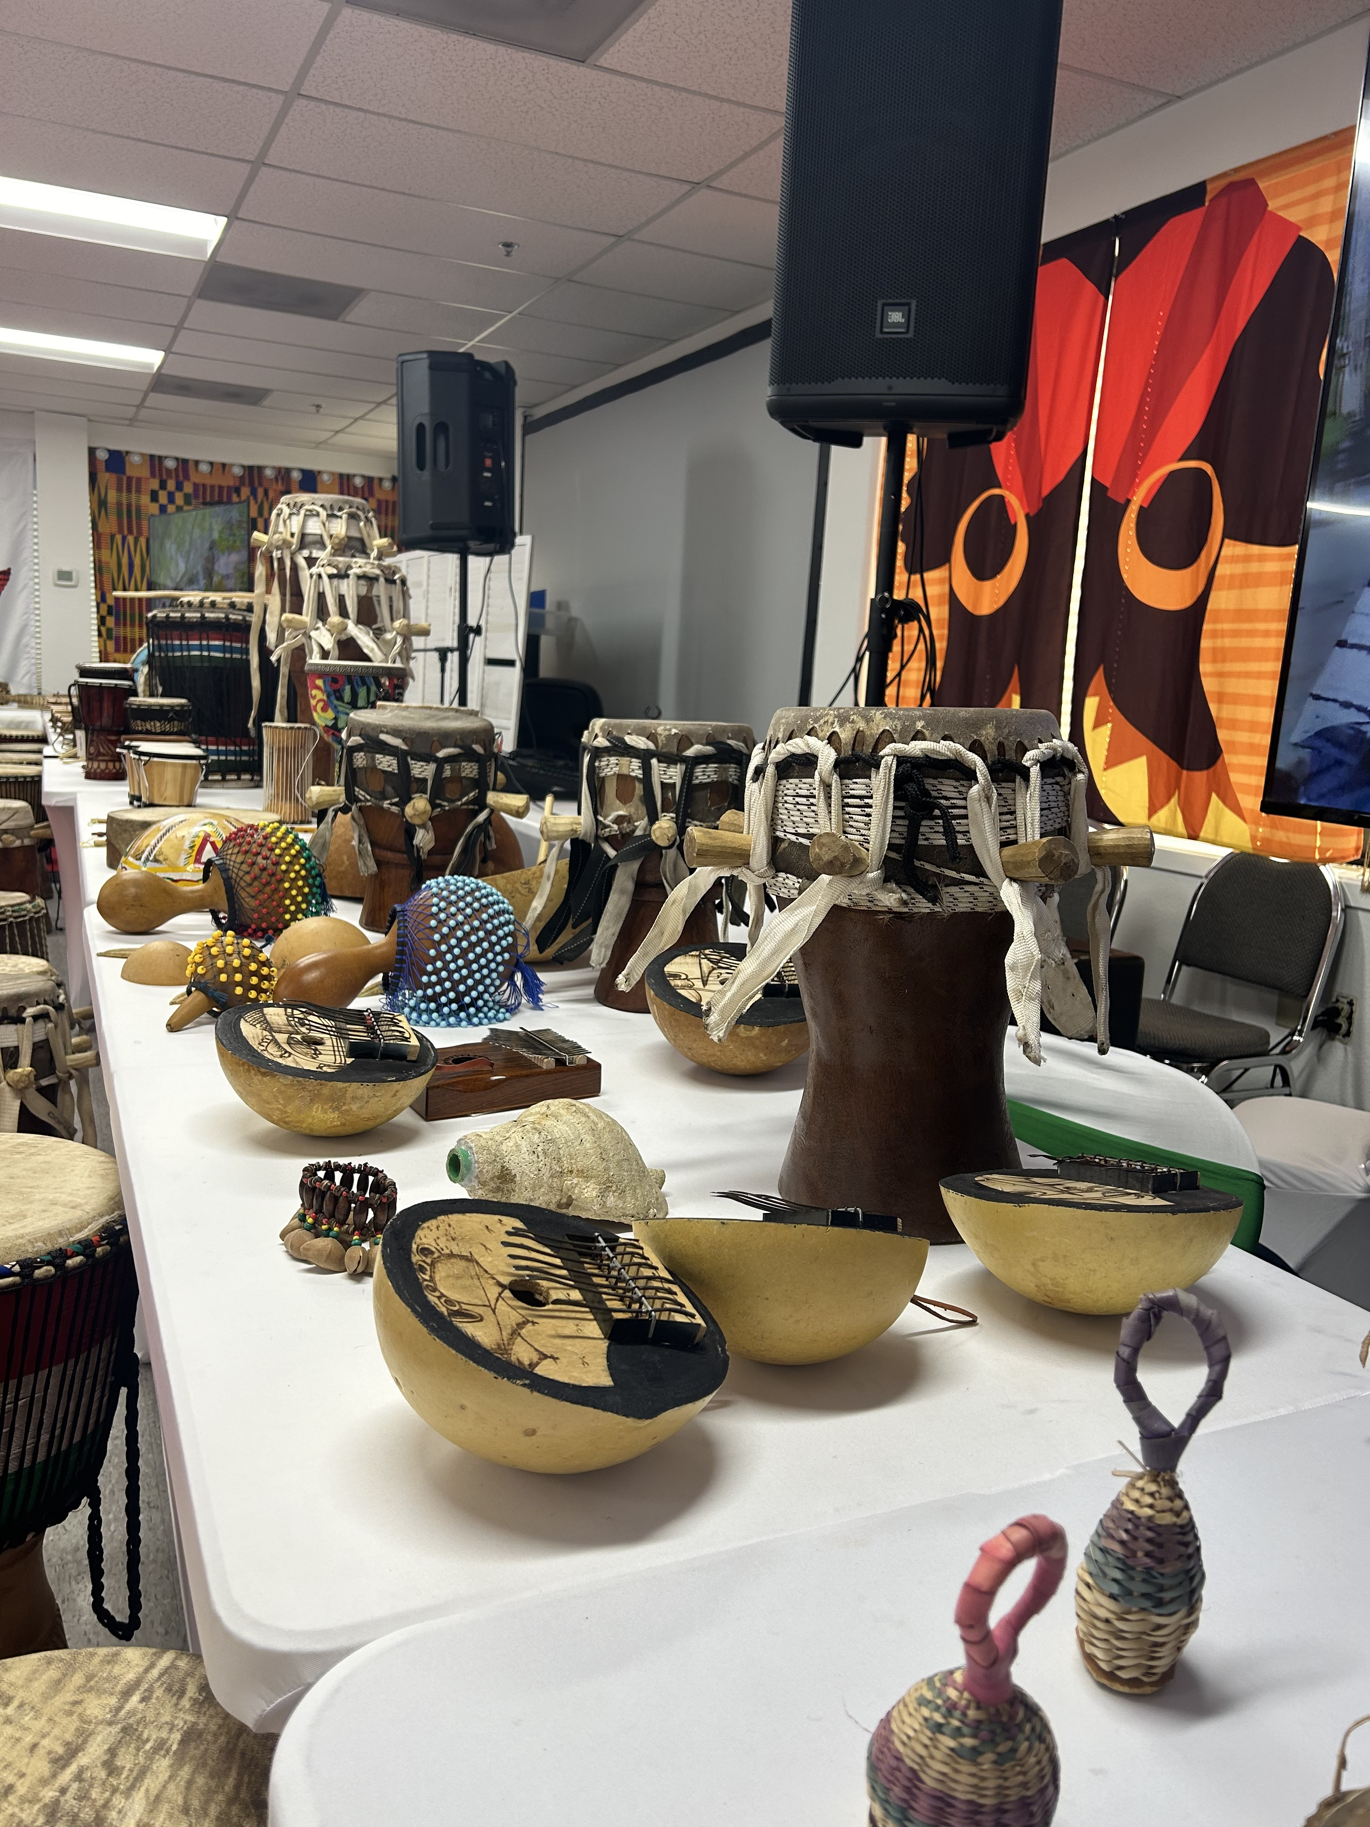
BACKGROUND
Established in 2017 in Lynwood, WA
Snohomish, Pierce, and King Counties
2-1-1 for 20,000 West Africans in WA
Provides wrapped-around services
Vibrant & Welcoming

Slide 3
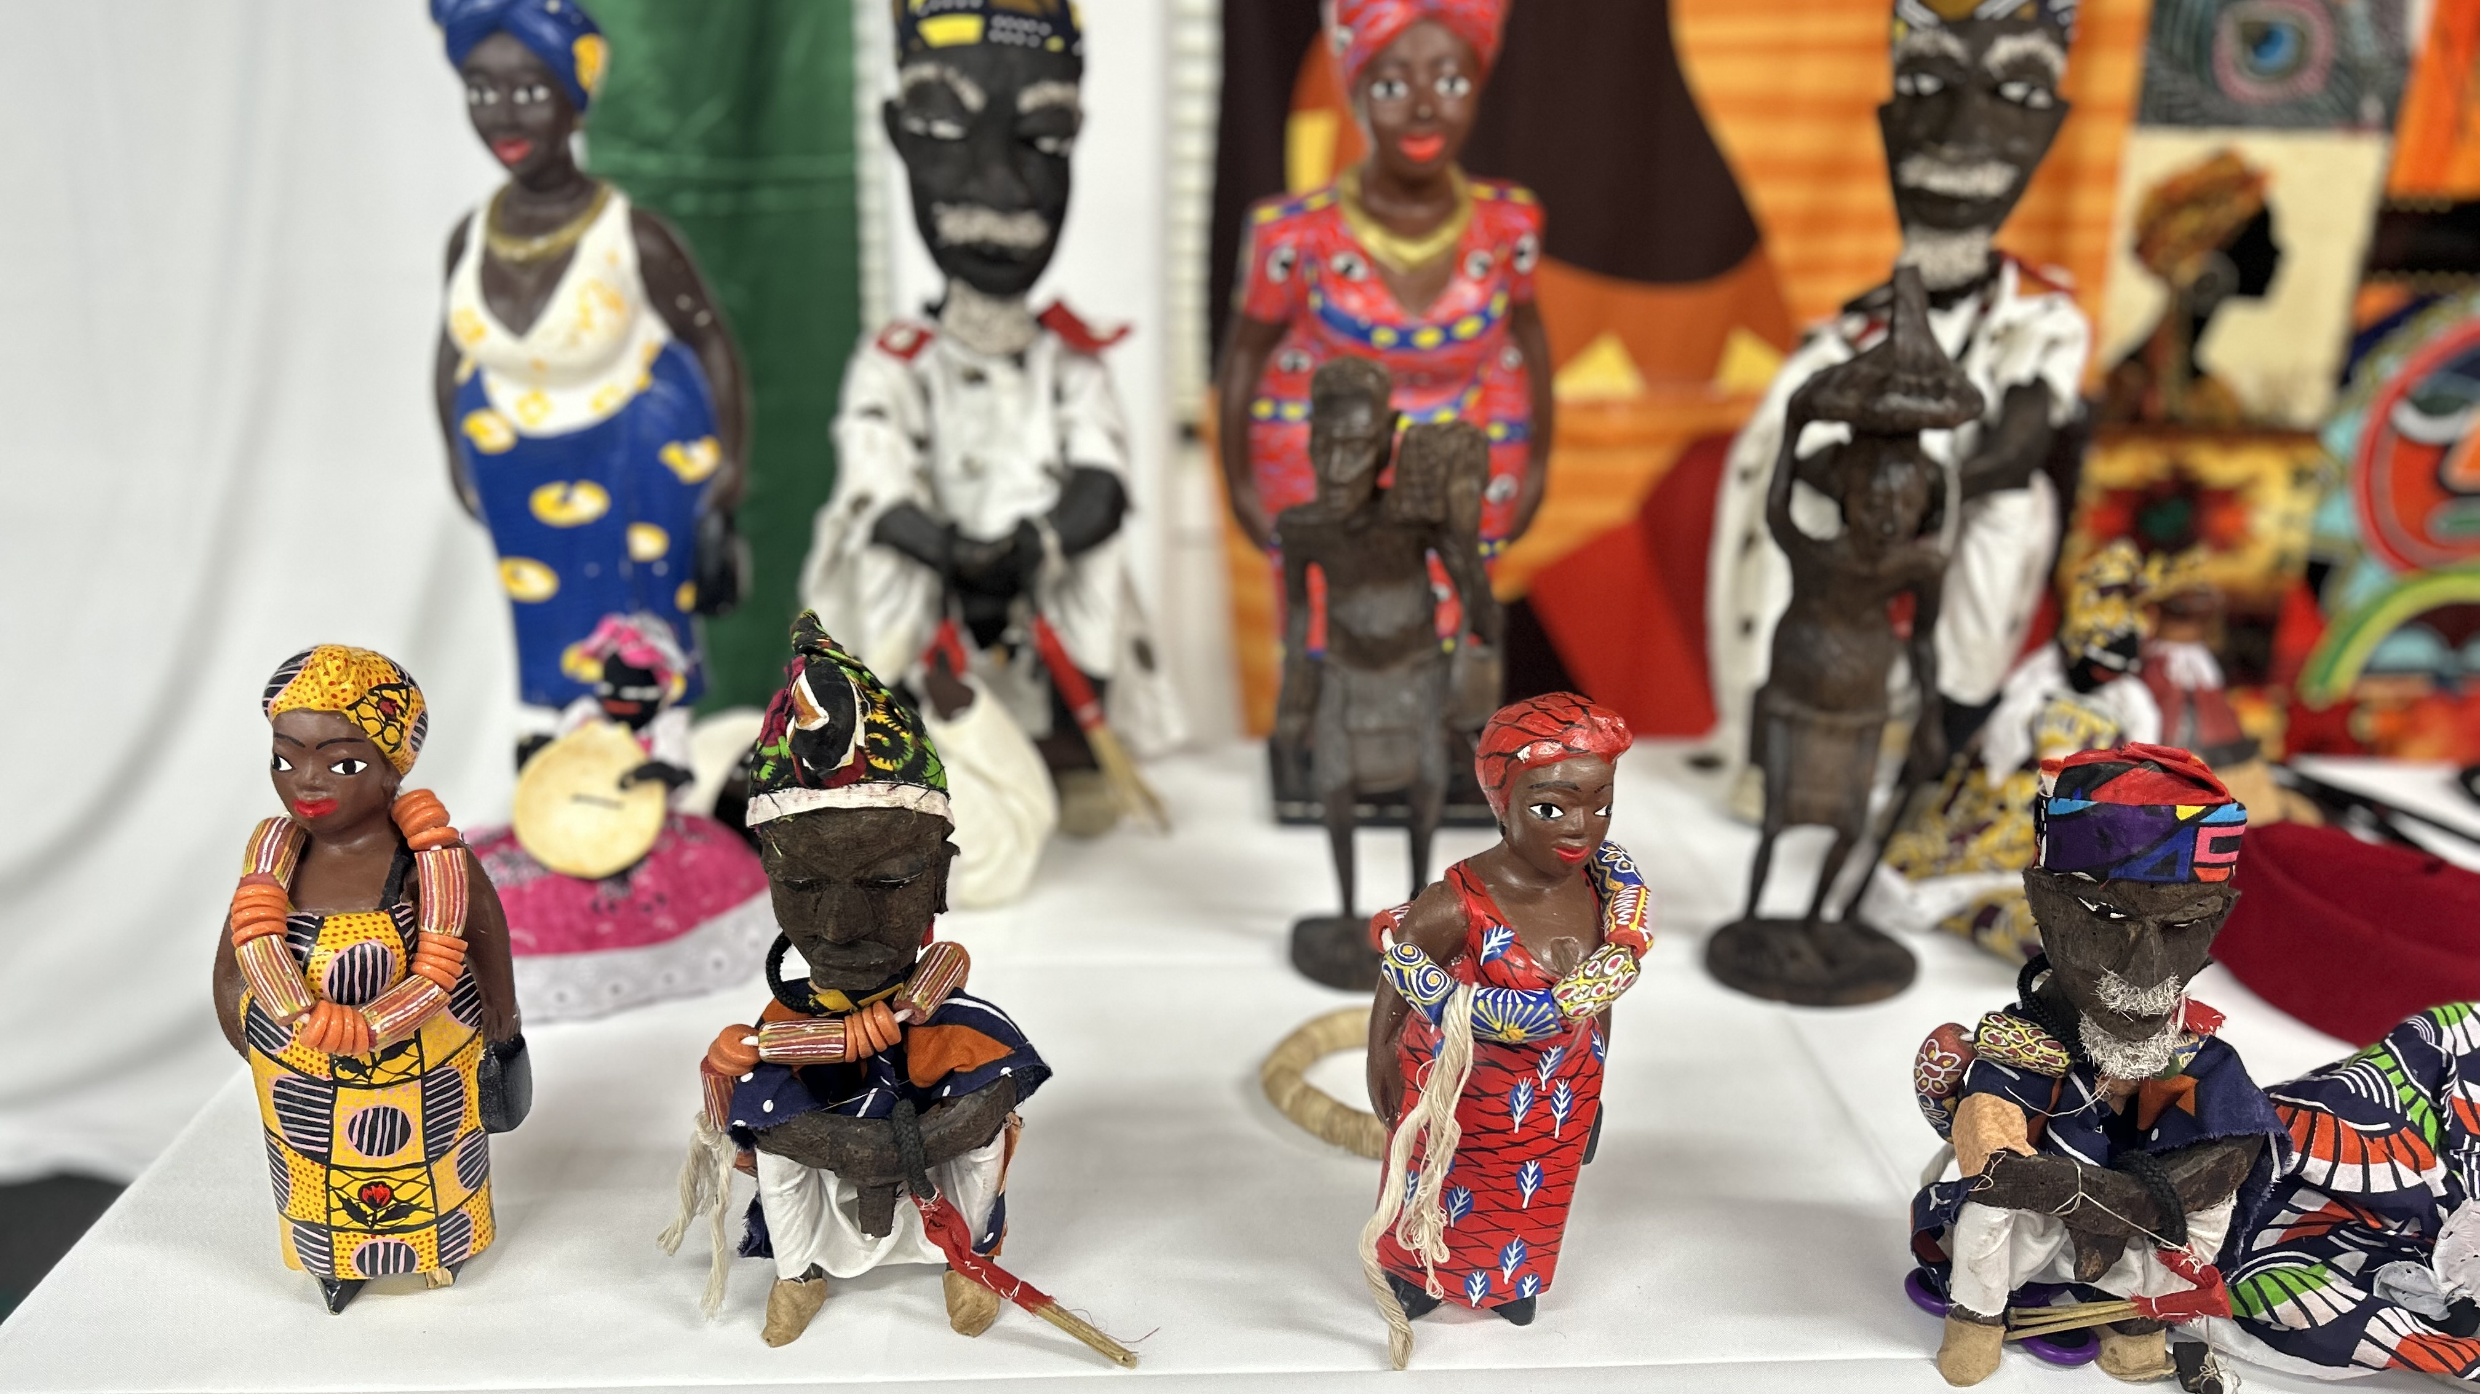
PROJECT OVERVIEW
Mental Health = organizational priority
Lack of existing information on mental health status
Gather preliminary data & community recommendations
Inform future programing & outreach efforts

Slide 4
METHODS
Background Research
Community Member Interviews
Staff Questionnaire
Rapid Qualitative Analysis

Slide 5
Community Member Interviews
Perceptions of Mental Health/Mental Well-Being
Strong Sense of Community Connection
Elements of Support-Seeking Behaviors

Slide 6
Staff Online Questionnaire
Perceptions of Mental Health & WAWAC Community
Frequency of Request vs. Referrals
Types of counseling services
Barriers & Recommendations

Slide 7
SUMMARY OF FINDINGS
1. Adults associate mental health with immigration struggles, worries, or stressors.
2. Kids have a general understanding of their emotions and are open talking about mental health/mental well-being.
3. Community members more likely to seek support from someone they know or trust.
4. Staff outwardly name mental health stigma or lack of awareness as an area of concern.

Slide 8

“I know many people who are facing that but they don’t know that they are facing that. They think that they are okay but they’re not okay. And you can feel it.”
WAWAC Community Member

Slide 9
KEY TAKEAWAYS
Addressing Mental Health & Stigma
Importance of Culturally Competent Resources
Linguistically & Culturally Relevant Educational Materials

Slide 10
KEY TAKEAWAYS
Addressing Mental Health & Stigma
Importance of Culturally Competent Resources
Linguistically & Culturally Relevant Educational Materials

Slide 11
KEY TAKEAWAYS
Addressing Mental Health & Stigma
Importance of Culturally Competent Resources
Linguistically & Culturally Relevant Educational Materials

Slide 12

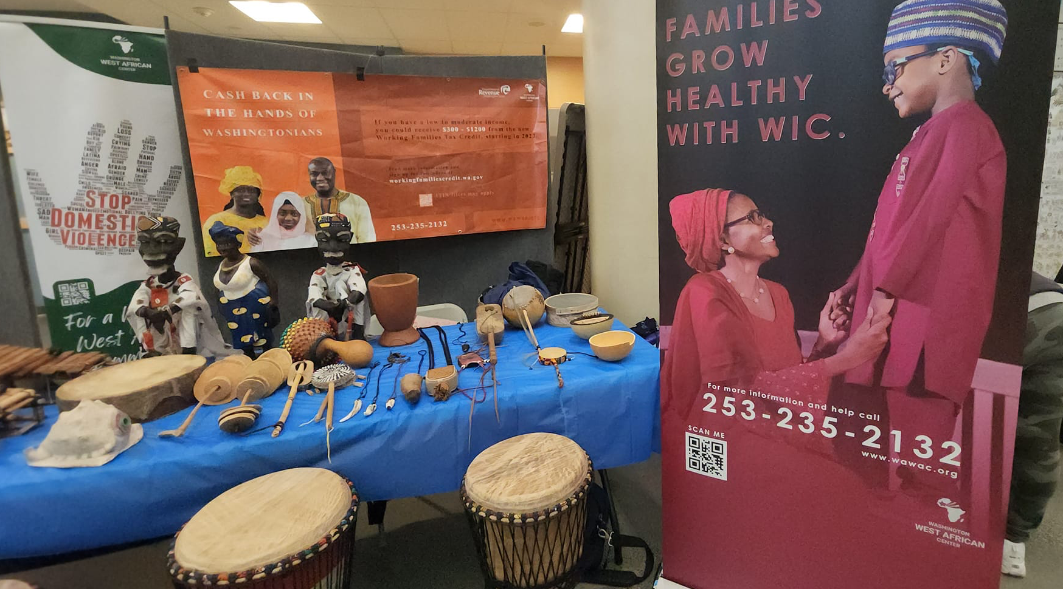


Slide 13
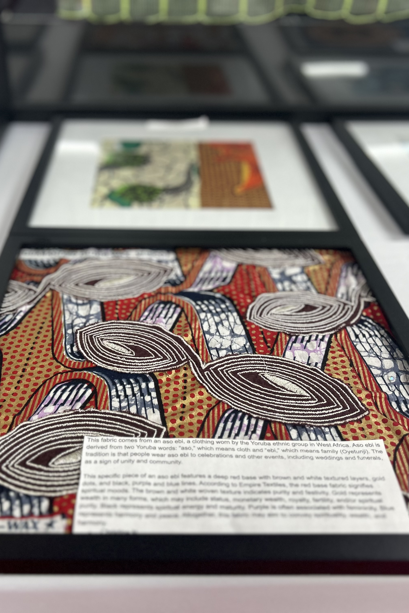
POTENTIAL NEXT STEPS
Integrate mental health awareness into existing programs & messaging
Share research findings with key service providers
Collaborate with other mental health & African non-profits in WA
Continue researching the needs of the West African community

Slide 14
THANK YOU!
Q&A

