Slide 1


Washington West African Center Community Health Assessment
By Alexandra Anthony
HSERV 354
Notes:
1- introduce yourself and your topic
2- talk about the specific population you are looking at and conducting this study on

Slide 2
Summary of the Problem
There was initial COVID-19 vaccine hesitancy within the West African community in Snohomish, WA when the vaccine was first rolled out. The population most affected was women, children, and the elderly (2).This community health assessment sheds light on what factors contributed to this hesitancy, specifically within the West African Community. We will dive deep into the main barriers and obstacles that resulted in this occurring as well as create an action plan to help prevent this from happening in the future.
Notes:
1- Emphasize the importance of looking into other methods of research
2- This CHA s important because we can dive deep to find out why we are getting certain results
3- we want to create more equitable care when it comes to getting the treatment you need

Slide 3
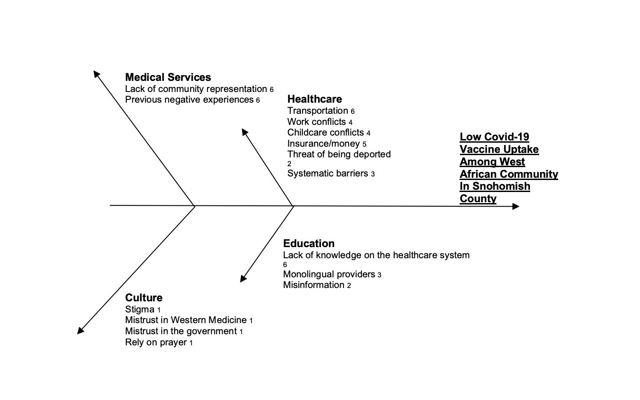
Root Cause Analysis
Notes:
1- talk about why root cause analysis is important, digging deep to find why we’re are seeing these outcomes instead of just looking at the numbers
2- Multiple factors are contributing to the barriers that people experience when trying to get the care they need
3- talk about the main issues you will diving into such as the fear of deportation, cultural differences, the spread of misinformation, etc.

Slide 4
Demographics
Population facts:
Over 161,000 Snohomish county residents (21%) live 200% below the federal poverty level (3)
Snohomish county’s population consists of 3.8% people who are black or African decent (1)
COVID facts:
There are over 761 vaccine locations in the Snohomish area* (4)
74% of Snohomish county is vaccinated (1)
West African specific details
There are over 20,000 west Africans in the state of Washington (5)
A large portion of these people are essential workers (2)
Notes:
1- talk about the population living below the poverty line, how many jobs that are considered essential work and the proportion of estimated west African people working these jobs
2- although there are many vaccine locations, the website that led me there specially talks about checking with your insurance and health care provider
Who is most at risk?

Slide 5
Overarching Questions and Research Methods
Guiding Question: What caused initial COVID vaccine hesitancy in the West African Community in Snohomish, WA?
Methods
- Thorough formative research
- Quantitative secondary research
- Quantitative and qualitative primary research
Scope of the Study
10 week time frame
WAC’s experiences with the health care system
Diving deep into how different cultures receive public health information
Considerations
Systematic, cultural, language barriers
Immigrant's attitudes and beliefs towards public health in American and individual medical providers
How racism is still imbedded within our system
Notes:
1- mention how given our time frame we may not have uncovered all possible barriers and root causes
2- it is hard to get quantitative data for issues such as racism and systematic barriers that are still existing in our society
3- although we were only able to talk to one person from the community, he is a huge stakeholder and asset within our specific community and was able to speak on the behalf of many individuals who have similar experiences to his own

Slide 6

Community Engaged Strategies
In this CHA we conducted our research by…
Coming in with non-biased attitudes. We are not here to coerce or persuade in way shape or form.
We strove to incorporate diversity in our secondary research by not excluding any demographics from our studies.
Considered positionality and power dynamics when interviewing members from the community.
Prioritized collaboration and inclusion when conducting our formative research.
Notes:
1- we asked about key informant about some key findings to see if it was truly accurate
2- always made sure to cross triangulate our sources
3- made sure to use quality sources opposed to blog

Slide 7
Summary of Secondary Research Methods Methods
Methods: For the first 4 weeks of this study, we researched issues like immigration status and healthcare, common west African cultural beliefs and practices, vaccination rates within the Snohomish area, as well as sites to get vaccinated.
Limitations: Some limitations to our study was that there is little information available that is West African specific. We had utilized some articles that touches on common struggles among immigrants in America. Issues like racism, sexism, and unequal treatment are not measurable and cannot be fully expressed in a writing.
Results: We had found that it is common for immigrants to avoid seeking healthcare due to fear of improper documentation or status (6). There was also a trend of bad past experiences that caused further hesitation when it came to seeking healthcare (2). Another contributing factor was normalized cultural practices within the community (8).
Notes:
1- We learned about common West African belief systems such as their feelings toward the Western heath care system and what is normalized in their community for how to handle certain health issues
2- It was hard to find west African specific data, but a common theme among immigrants is fear of deportation by trying to seek medical help
3- another fear specific to WA is that culturally they are known to rely on prayer when it comes to sickness , getting the vaccine might have others in your community look at your different as well as make one feel like an outsider 4- make sure to emphasize that a lot of this data was taken from articles that just used immigrants as a blanket statement and it was not specific to the WA community

Slide 8

Primary Data Collection
Methods: For our primary data collection, we collaborated with a key stakeholder within the West African community, Pa Ousman Joof. We conducted an in-depth 13-question interview to help shed light on his personal experiences as a West African immigrant during the COVID 19 pandemic. We also used this interview to cross triangulate the data we had found during our secondary research.
Notes:
1- dive deep into what went into creating the interview questions.
2- We had brainstormed many ideas and have about 3x as many questions than what we ended up asking him. We chose the most crucial question based more on qualitative data that we could not find online
3- it is imperative that you ask questions more about his experiences/ community experiences because this study was focused on finding what was behind the numbers we were finding
4- we selected a handful of questions regarding what we found during our research to see if these reports were accurate.

Slide 9
Primary Data Continued
List of Challenges
Access to healthcare
Misinformation
Cultural accommodations in a public health setting
- Restricted funding
- Transportation
Language barriers
Not only was this an issue when it came educating oneself about the vaccine, but also created a barrier of where to get medical attention
List of Strengths
“If we don’t have it, we will find it!” - Pa Ousman Joof
- WAWAC Opened 30+ vaccine site pop-ups and achieved 5,000+ vaccinations in the Snohomish community
Offered supplemental pay to get vaccine
Offered transportation, childcare, counseling, translation services
Creates community and interconnectedness
Notes:
1- Misinformation was a large contributor to vaccine hesitancy as well, what makes this issue even worse is the language barrier and not being able to receive accurate information
2- in the west African culture it may not be appropriate for a women to have a male doctor, we need to have accommodations for issues like this
3- WAWAC has had many successes – needs help with more unrestricted funded

Slide 10
Data Analysis Plan
We cross-triangulated and integrated our findings from our primary data collection with our secondary data search to determine what had contributed to the initial low vaccine uptake among the west African community in Snohomish, WA. With this information we utilized the socioeconomic model as a guide to create a detailed, time-oriented plan addressing the major gaps that were identified within this community.
Notes:
1- touch on the confirmed findings such as immigration being a large contributor as to why people weren’t seeking medical help
2- talk about other confirmed barriers such as the language barrier and misinformation that was enhanced from this issue
3- we also learned about how certain policies that are in place are keeping these people from getting the help they need (housing/routine care)

Slide 11
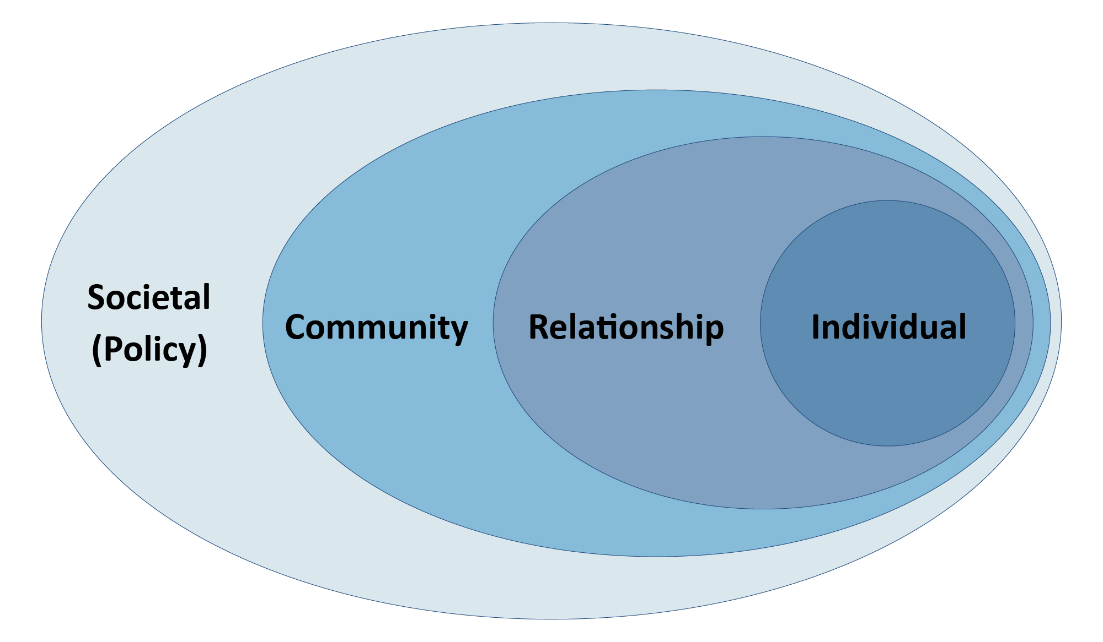
Socio-ecological model
Individual
Language barrier/misinformation
Relational/Interpersonal
Lack of transportation
Community
Lack of space to come together
Policy
- Required documentation to receive medical attention
Notes:
1- This all ties in to the socio-ecological model, each layer has a set of it own issues, this perpetuates the issues
2- These are some or the major concerns we found based on our studies. Each of these issues have a plethora of problems tagging along to it, we need to intervene and find solutions so that we can improve the quality of our healthcare system and make it an equal and inclusive as possible

Slide 12
Action Plan
Goals | Activity | Outcome | Timeline | Actors
Enabling individuals to seek out knowledge about public health issues | Provide digestible public health flyers throughout the community in multiple languages | Stop the spread of misinformation | 1 year | Oneself
Encouraging friends and family to care for their health and well-being | Have WAWAC leaders for closer relationships with people in the community | Increase a greater portion of the community to get routine medical care | 3 years | Friends and family
Build a community Center | Find plot of land to build community center, locate funding for project | Having a place for administering vaccines | 5 years | Community leaders & stakeholder WAWAC
Host courses on how to identify misinformation | Hire volunteers that can help educate community members | Providing an opportunity for education the community | 2 years | WAWAC community
Have schools, churches, community, provide state and local public health information | Translate public health flyers into multiple West African languages | Increasing the flow of accurate and up to date medical information | 6 months | Translators Community leaders
Be able to adapt to helping communities with different cultures | Identify funding prospects for educating health workers on cultural accommodations | Creating a more culturally accommodating healthcare system | 3 years | Healthcare professionals Policy makers
Notes:
1- Talk about the reason I chose these goals (based off individual, relational, community, and policy issues that needed to be addressed
2- a lot of these goals are long term goals, this is because there are some large changes to made – especially within the policy realm
3- this objectives were made based off the analysis of both our primary and secondary data to address to gaps in the community, these goals need cooperation from many different actors including individuals within the community, health care professionals, policy makers, government, etc.

Slide 13
Dissemination Plan Plan
Host monthly peer gatherings in the community
Collaborate with Snohomish county schools and churches to host meetings to update them on our project and gather feedback on how to improve
Work with medical case managers
Educate on how the procedures are having an impact on the health of immigrants in our community
Gather feedback on logistics and putting plan into action
Continuously work with and maintain relations with WAWAC and the Snohomish community to collaborate and update them on the projects progress
Notes:
1- explain why it is important to share our finding with people within the community
2- our key informant emphasized how important it was for outsides to be able to listen to how their community is able to intake information, it is crucial to maintain a relationship with the community and have constant back and forth communication to make sure we are addressing the communities needs
3- hosting monthly meetings is a great way to stay connected to the community and make sure we are always progressing to a better end product. It is imperative that we continue to grow and obtain as much feedback as possible

Slide 14
References
1- “Snohomish County Profile.” ESDWAGOV - Snohomish County Profile, https://esd.wa.gov/labormarketinfo/county-profiles/snohomish.
2- Pa Ousmane Joof, Zoom interview, May 11th
3- “Low Income Needs Assessment.” Low Income Needs Assessment | Snohomish County, WA - Official Website, https://snohomishcountywa.gov/1084/Low-Income-Needs-Assessment#:~:text=Landscape,of%20%2424%2C980%20for%20an%20individual.
4- Vaccinate Wa: Covid-19 Vaccine Availability, https://vaccinelocator.doh.wa.gov/locations/98290.
5- “Home.” Washington West African Center (WAWAC), https://wawac.org/about-wawac/.
6- Hacker, Karen, et al. “Barriers to Health Care for Undocumented Immigrants: A Literature Review.” Risk Management and Healthcare Policy, Dove Medical Press, 30 Oct. 2015, https://www.ncbi.nlm.nih.gov/pmc/articles/PMC4634824/.
7- Alfonseca, K. (2020). How Coronavirus is Affecting the Latinx Community’s Mental Health. HuffPost. Available at https://www.huffpost.com/entry/coronavirus-impact-latinx- mentalhealth_l_5ea9b743c5b6acde47fe7599?ncid=APPLENEWS00001&guccounter=1
8- Seydou, Aminatou. “Analysis | Africa Has Started Vaccinating against the Coronavirus. but Do Citizens Trust Their Governments on Vaccine Safety?” The Washington Post, WP Company, 12 Mar. 2021, https://www.washingtonpost.com/politics/2021/03/12/africa-has- started-vaccinating-against-covid-do-citizens-trust-their-governments-vaccine-safety/.

Slide 15
Appendix and extra resources

Slide 16
Interview questions
What are the predominant health challenges and predominant health strengths for the WAWAC community?
What are general perceptions of the community regarding vaccines in general?
What were the main narratives around the COVID-19 vaccine when it was first rolled out within the Snohomish West African community?
Was there a general consensus of support/apprehension, or multiple vaccine attitudes?
What members of the WAWAC community have been most affected by COVID-19?
Are there members who have been more burdened than most by COVID-19?
How have vaccination trends changed or stayed the same since the initial roll-out?
We’ve done some research about vaccine hesitancy. What factors would you say contributed to vaccination hesitancy within the West African community?
Of these factors you mentioned, which three were most important?
What forms of media have you seen WAWAC community members become most responsive to in obtaining new information, especially regarding the COVID vaccine?
How does immigration status impact the general health of the WAWAC population?
How does immigration status impact COVID-19 perceptions and vaccine perceptions?
What are the greatest challenges that community members dealt with to attend vaccination appointments?
What services WAWAC hopes to grow to offer community members in the future?
What are some ways healthcare workers can better serve the West African community?
What could they have done to improve vaccine rates?
What is the specific role of WAWAC in improving vaccine rates?
What sorts of interactions did WAWAC have with policymakers (i.e. DOH, SHD, others)?
What do you say are the community strengths that promote positive health and wellness for WAWAC community members? [ask for explanations of these strengths and how they work to promote health]
If we were to experience another pandemic, what steps would you wish to be taken differently to prevent the kind of problems we saw this time around?

