Slide 1
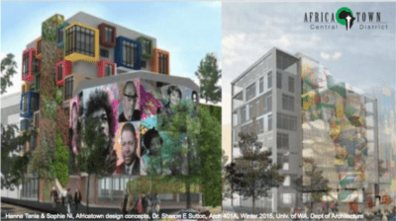

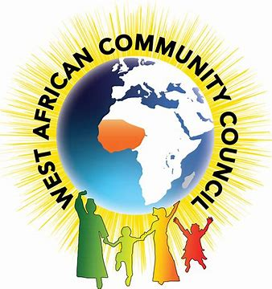
345 HSERV
Community Health Assessment
Notes:
Greetings everyone, my name is Tyree Long, and today I will present my Community Health Assessment nn the West African immigrant community

Slide 2
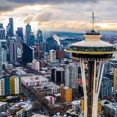
West African Immigrant community of the greater Seattle area problems
High Domestic Violence
High Divorce rates
Confidentiality
Immigration
Notes:
Read slide as is “maybe give an anecdote on immigration status”

Slide 3
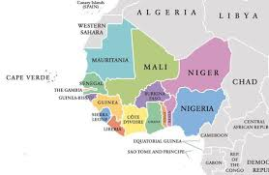
Immigrating Countries
The West African community in greater Seattle is a strong diaspora consisting of over 20 thousand from 18 countries.
Notes:
The Diaspora of the West African community consists of 16 countries in King County from Mali, Guinea, Senegal, Ivory Coast, Nigeria, Gambia, Liberia, Burkina Faso, Mauritania, Guinea-Bissau, Benin, Cape Verde, Ghana, Sierra Leone, Togo, and Niger.

Slide 4
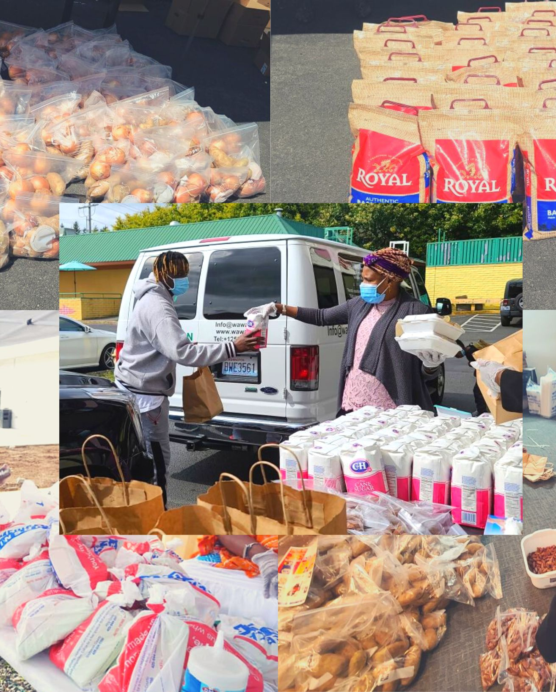
Summary of community
The West African Immigrant community while living in this region all share common challenges.
Culture shock
Family dynamic changes
Language barrier
Economic power
Immigration
Notes:
Culture shock from the differences of cultures once immigrating. The family dynamic changes due to shifts in income amongst sexes. Language barriers. Immigration is a major challenge for the community due laws and policy or even finding lawyers they can afford.

Slide 5

Overview Analysis
What challenges are faced by the Domestic violence survivors in the West African community and how can we help them cope with them?
How can we best engage with Immigrant West African women in programs and services to prevent domestic violence?
What cultural and social factors may influence women's experiences and perceptions of domestic violence?
Notes:
These are some questions I looked at to better inform intervention strategies and increase collaboration with the community.

Slide 6

Scope of assessment
Investigate needs and gaps of resources/services for West African immigrant families to create interventions that enable them to accurately identify and receive care for domestic violence.
Strengthen family unit
Improve existing services
Uplift and empower community
Notes:
As a student the scope of our assessment is to help identify needs and gaps of resources available to West African immigrant populations experiencing domestic violence..

Slide 7
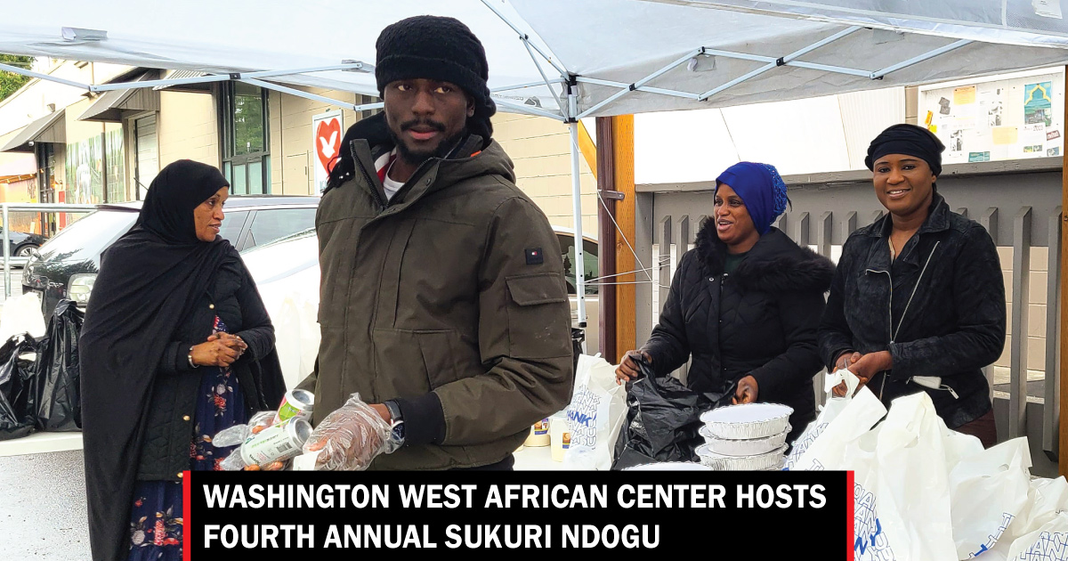
Methods
Analysis of Existing Data
Key Informant interview
Health Communication
Health education
Notes:
These are the methods used to help create my action plan.

Slide 8
Time frame of Analysis
3 Month window
Existing Data collection
Resource mapping
Demographics of population
Pre-existing conditions of population
Culture norms
Informant interview Prep
Analysis of data
Investigate gaps of service
Create Questions
Interview & formulation of plan
Conduct interview
Compare and contrast data
Provide findings & possible solution
Notes:
In march we were introduced to community health assessments and begin our formative research on the West African Immigrant community. During this time wes learned of their demographics, culture norms, and pre-existing conditions. This research continued throughout the 3 months culminating in our informant interview that help us understand issue at deeper level helping us pinpoint the needs of the community and gaps that secondary data lacked..

Slide 9
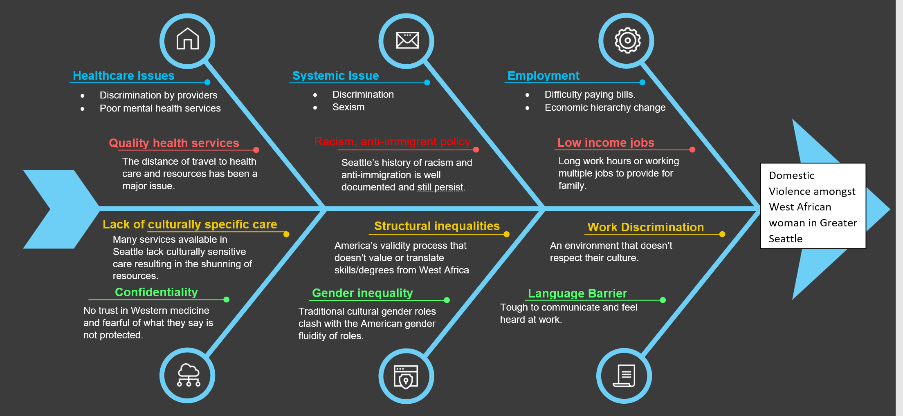
Notes:
Domestic violence amongst West African woman in great Seattle derives from 3 major domain employment Systemic racism, and Healthcare. Coming to America family dynamics change as man experience lowering paying wages, work discrimination and language barriers. This impacts mental health and can cause strain on interpersonal relationships. The trauma and stigma faced from structural racism takes a toil on all parties resulting in lashing out within the family.

Slide 10
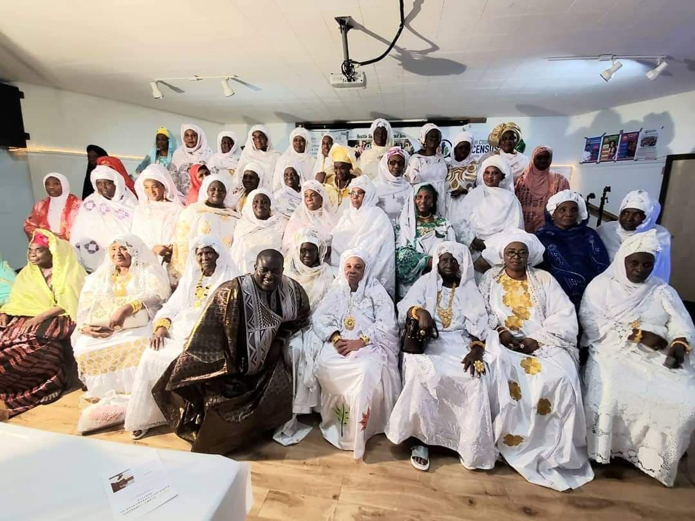
Engagement strategy
Center activities on community needs
Value Informed Approach
Active listening
Provide a safe space
Notes:
As a research team, we aimed to center activities on community needs by talking to insiders inside the community and gaining a better understanding of the needs. We pursued a value-informed approach by recognizing the customs and culture and creating interventions tailored by them. We listened for understanding and actively listened to promote equity and a safe space.

Slide 11
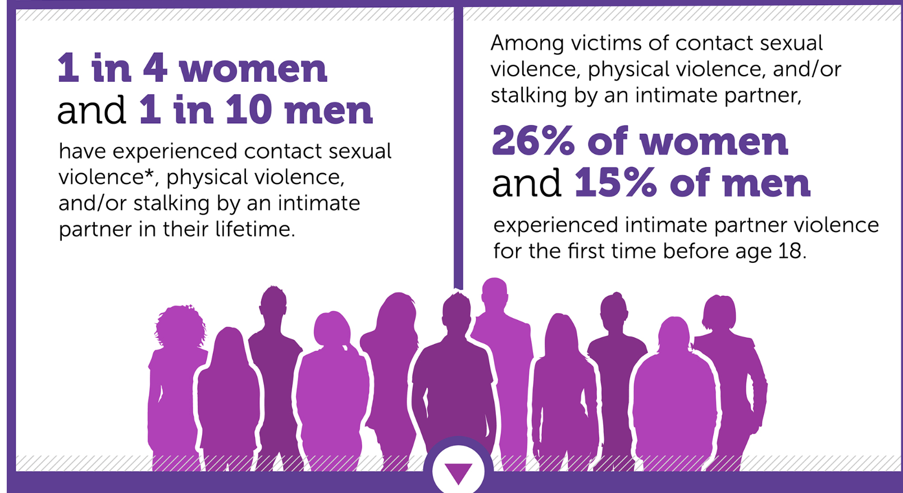
Secondary research Method
Formative research
Most of the members of the West African community work in the hotels, food and hospitality industries, hair salons, and rideshare (1)
Access to first-hand language is limited because most of the West African languages are not written. (1)
Quantitative data
402.5 Emergency Department visits for nonfatal physical assault injuries per 100,000 in 2020 (2)
Over 43 million women and about 38 million men experienced psychological aggression by an intimate partner in their lifetime (3)
Notes:
From our formative data, we learned where most West African immigrant communities work. We learned some interesting things about the many cultures languages customs and traditions. Our Quantitative data informed us risk factors of domestic violence and how it is one of the most underreported crimes in America according to the CDC.

Slide 12

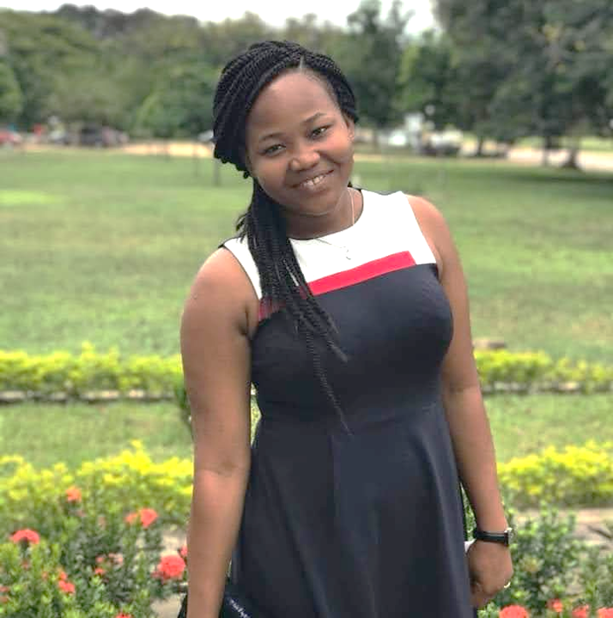
Primary data collection Plan
Ousman Jarju
WAWAC Director
Informant Interview
Process of grant writing
Frustration
“Improper Identification of domestic violence” -Ousman
Patience
MPH student
Experience: Intern for Domestic Violence Program at WAWAC
Notes:
In our primary data collection, we were informed of the grant writing process and learned of the frustration many West African men face while adjusting within this country. Ousman explained that families often do not even realize they suffer from domestic violence, and barriers to the program currently.

Slide 13
Ecological Model
societal
Community
relationship
Individual
Individual
Community
Relationship
Societal

Slide 14
Action Plan
Notes:
My action Plan Aligns with the needs and gaps found through both primary and secondary data.

Slide 15
Dissemination of Findings
Present findings to local community groups and stakeholders in mosques , community centers, and town halls Bi-annually
Host press events to summarize findings and progress of the plan quarterly to stakeholders.
Conduct monthly check-ins with partners and community collaborators.
Notes:
Read from slides

Slide 16

Thank You 345 HSERV
Community Health Assesment

Slide 17
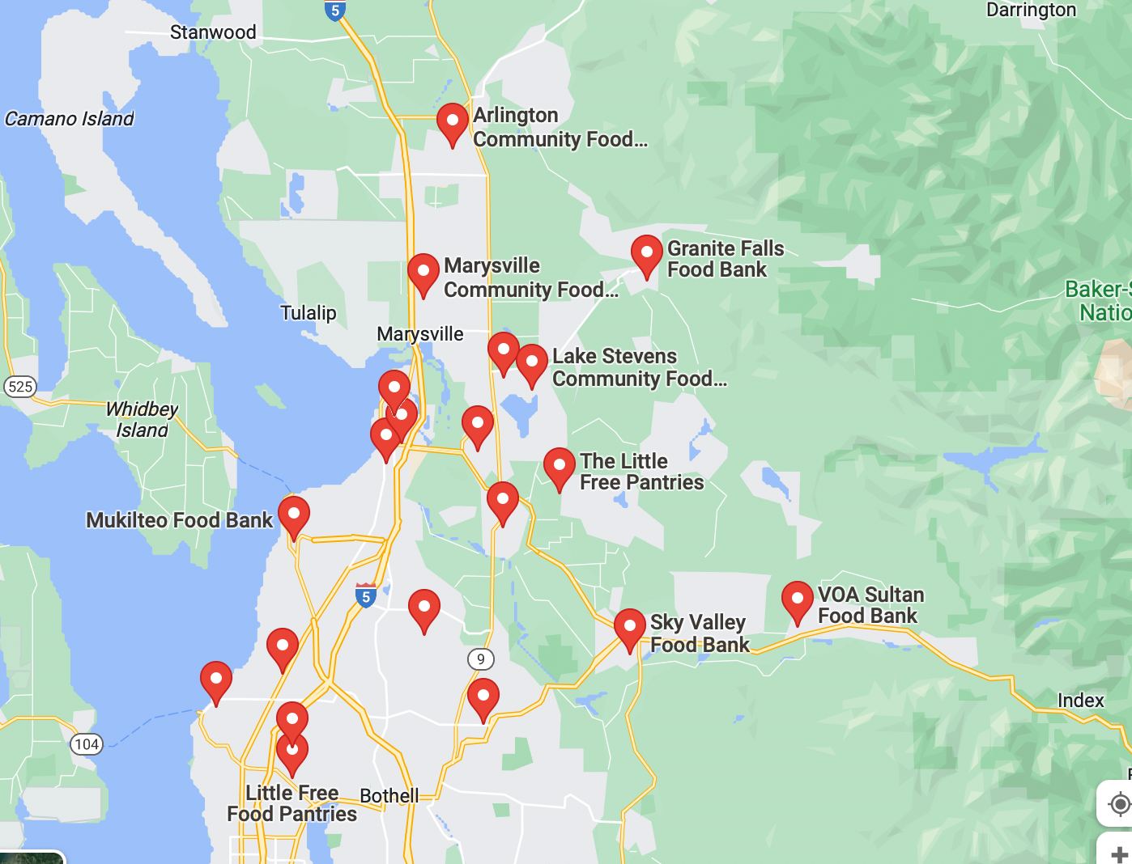
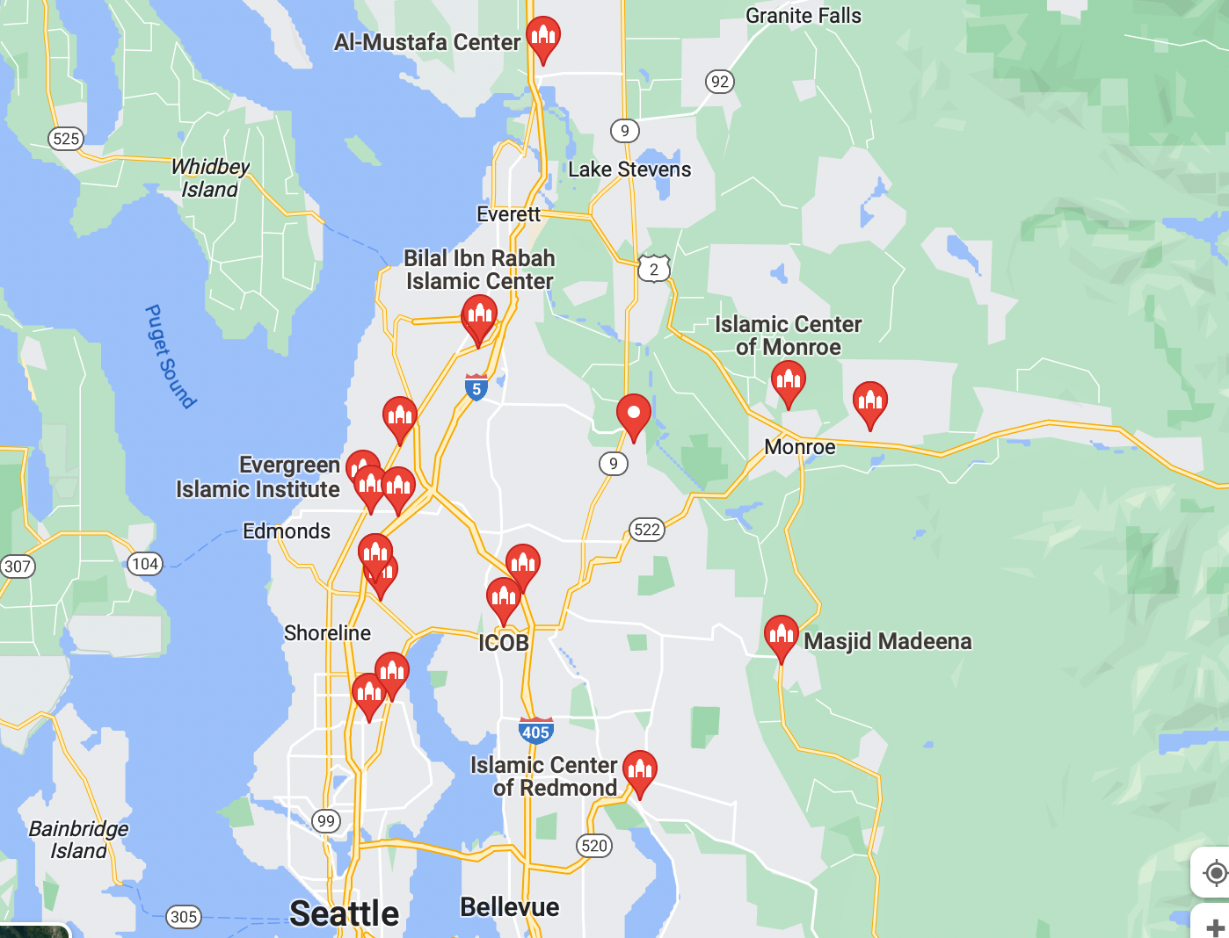
Appendix
Rapport building questions:
Introductions
Hello, thank you both for making it here today.
How are you today? How was your trip to New York?
How has your morning been going so far?
When did you get involved with WAWAC?
What do you enjoy about working with the West African immigrant community?
Interview Final Questions
How frequently does domestic violence get reported among the West African community?
Follow-up: Who is most frequently involved?
How do spouses in this community express and handle domestic disputes?
What perspectives do women and men have on their role as a spouse (wife/husband) or parent? How do they define their role?
How do you describe the domestic violence issue in the community?
Probe: Is it improving, stagnant, or worse?
Follow up: If improving, what factors or resources are helping to make this change?
What strategies can we use to support West African Women in accessing and utilizing healthcare services?
Can you tell us about some barriers that may prevent West African Women from seeking care?
How often are women likely to report domestic violence they have experienced?
What gaps are being addressed and with what organizations?
Are there any gaps in your current work with domestic violence and how do you imagine that they can be addressed for the community at WAWAC?
Asset List:
Shelters that they connect with to provide victims of DV somewhere to stay temporarily, Crisis Connection Center (211 phone number).
Grant provided by the government to assist families with financial issues.
Adult literacy classes from WAWAC and Northwest Immigrant Rights project
Grocery assistants
Grandmas assisting domestic violence survivors
After school program
Northwest Immigrant Rights project
Interpretation and translation services
Free legal assistance for immigration issues from the Office of Immigration and Refugee Affairs.
Housing and Other Finance Assistance from Office of Immigrant and Refugee Affairs
Insurance assistant
Food banks
Volunteers
Food Banks in Snohomish County
Mosques in Snohomish County

Slide 18
Bibliography
About WAWAC – Washington West African Center (WAWAC). https://wawac.org/about-wawac/
Intimate Partner Violence |Violence Prevention Publications|Violence Prevention|Injury Center|CDC. www.cdc.gov. Published May 4, 2020. https://www.cdc.gov/violenceprevention/communicationresources/infographics/ipv.html
Reduce nonfatal physical assault injuries — Data - Healthy People 2030 | health.gov. health.gov. Accessed June 5, 2023. https://health.gov/healthypeople/objectives-and-data/browse-objectives/violence-prevention/reduce-nonfatal-physical-assault-injuries-ivp-10/data
Reduce sexual or physical adolescent dating violence — Data - Healthy People 2030 | health.gov. health.gov. Accessed June 5, 2023. https://health.gov/healthypeople/objectives-and-data/browse-objectives/violence-prevention/reduce-sexual-or-physical-adolescent-dating-violence-ivp-18/data

